Slide 1

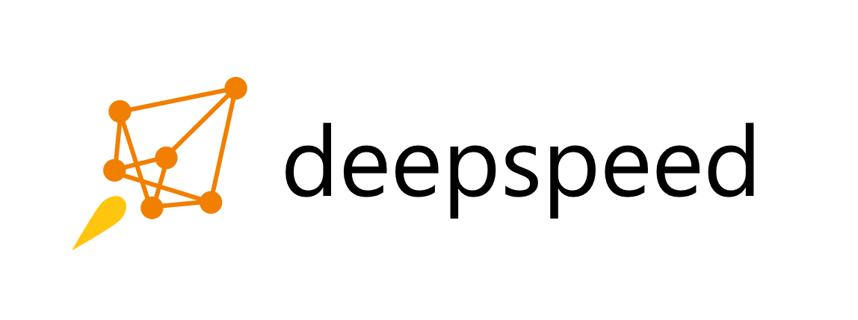
Large Scale Memory Efficient Learning w. ZeRO and DeepSpeed
http://www.deepspeed.ai
Jeff Rasley, Olatunji Ruwase, Samyam Rajbhandari

Slide 2
Open-source DL library accelerating large scale training and inference on-top of PyTorch
https://github.com/microsoft/DeepSpeed
ZeRO
3D Parallelism
MoE training + inference
Optimized CUDA/ROCm/CPU kernels
Transformer, Adam, LAMB, AdaGrad, MoE
Optimized communication libraries
1-bit Adam/LAMB
Mixed precision training
Profiling and Auto-tuning
Sparse Attention
Mixture of Quantization (MoQ)
Progressive Layer Drop (PLD)
Curriculum Learning
Elastic training
Advanced learning rate schedules

Slide 3
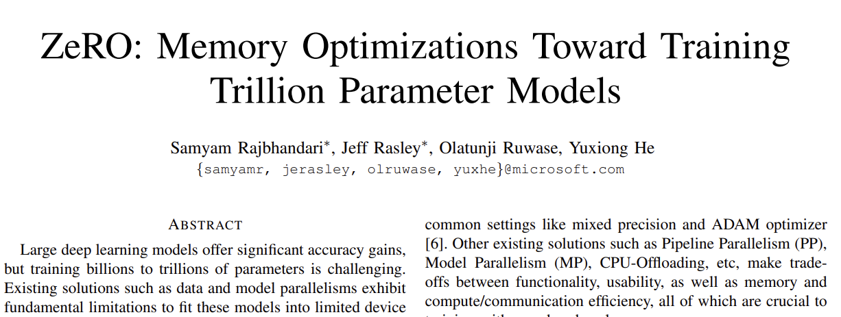
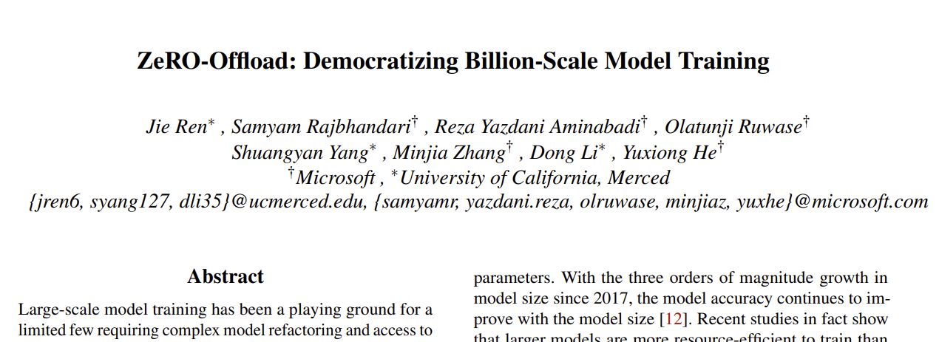
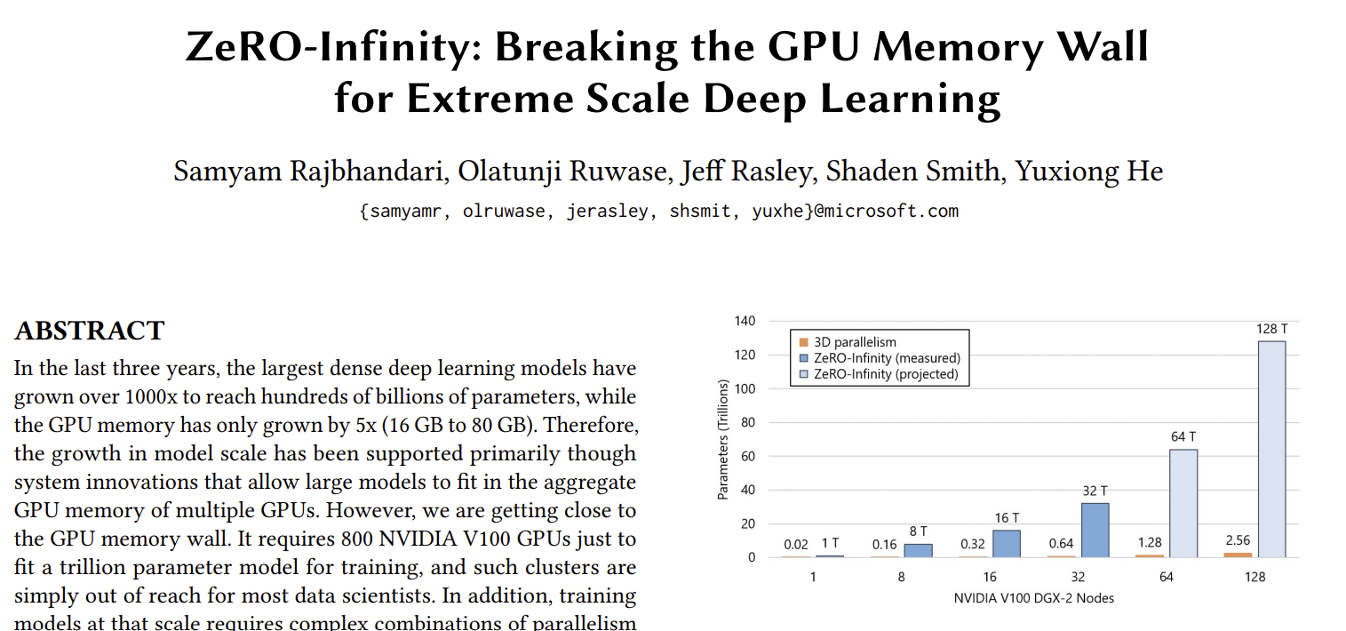
Outline
The ZeRO family of optimizations
ZeRO: memory optimizations toward training trillion parameter models (SC ‘20)
ZeRO-Offload: Democratizing Billion-Scale Model Training (USENIX ATC ‘21)
ZeRO-Infinity: Breaking the GPU Memory Wall for Extreme Scale Deep Learning (SC ‘21)

Slide 4
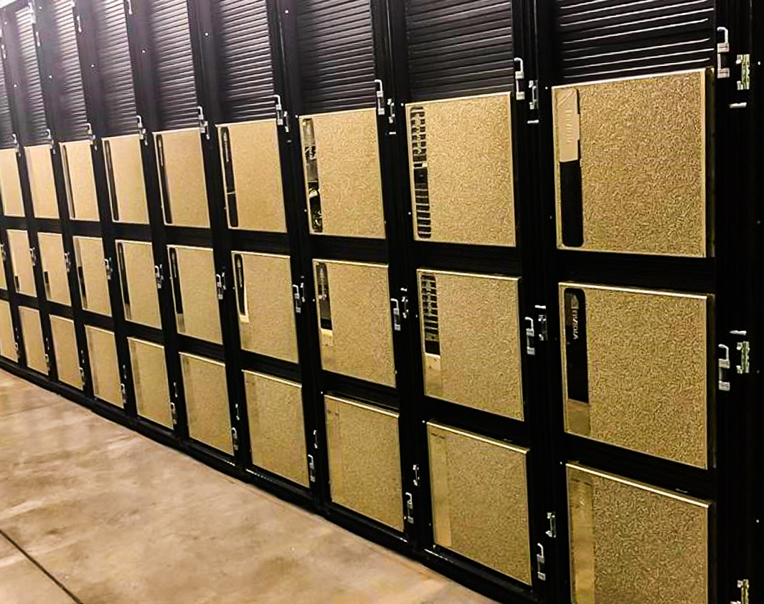

ZeRO: Memory Optimizations Toward Training Trillion Parameter Models
Samyam Rajbhandari, Jeff Rasley, Olatunji Ruwase, Yuxiong He
The DeepSpeed Team, Microsoft

Slide 5
Outline
Motivation
ZeRO capability overview
Understanding Memory Consumption
ZeRO-DP: ZeRO powered data parallelism
Evaluation
Notes:
Let me start by motivating the problem and offering a quick overview of our solution.

Slide 6
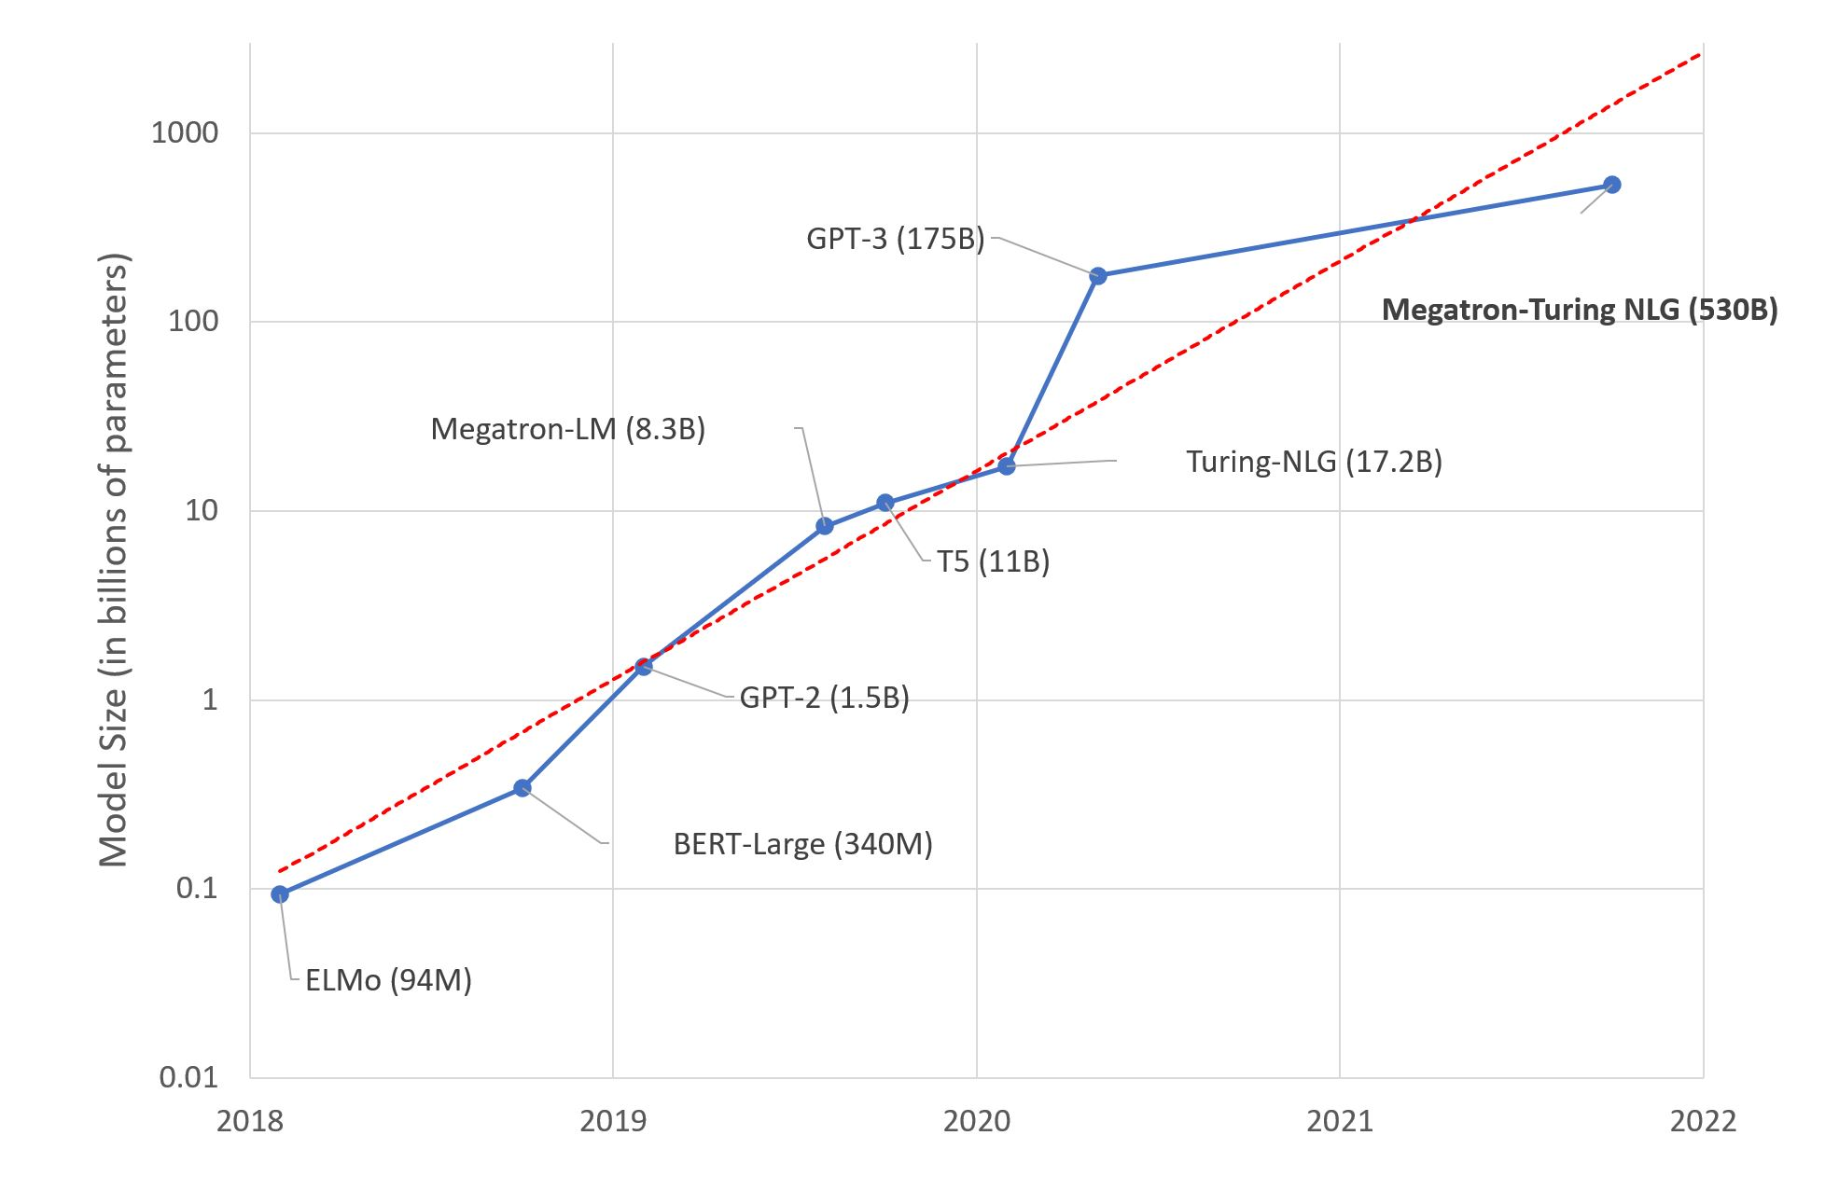
Why large model training?
Models are growing in size, and we have not reached the accuracy limit
More compute efficient to train larger models than smaller ones to same accuracy
Notes:
Model sizes has been increasing at an exponential rate in the last couple of years.
Just 4 years ago, the largest language model had less than 100M parameters
Now the largest dense model has over 500B parameters, over 3 orders of magnitude in model size in less than 4 years.
This increase in parameter size has resulted in significant improvement in model accuracy.
Recent research shows that LLMs are more compute efficient than smaller models to achieve similar accuracy
We expect parameter counts to continue to grow, and LLMs to become increasingly more useful

Slide 7
State-of-art and its limitations
 | Max Parameter (in billions) | Max Parallelism | Compute Efficiency | Usability (Model Rewrite)
Data Parallel (DP) | Approx. 1.2 | >1000 | Very Good | Great
Model Parallel (MP) | Approx. 20 | Approx. 16 | Good | Needs Model Rewrite
MP + DP | Approx. 20 | > 1000 | Good | Needs Model Rewrite
Pipeline Parallel (PP) | Approx. 100 | Approx. 128 | Very Good | Needs Model Rewrite
PP + DP | Approx. 100 | > 1000 | Very Good | Needs Model Rewrite
MP + PP + DP | > 1000 | > 1000 | Very Good | Needs Significant Model Rewrite
ZeRO | 1000 | 1000 | Very Good | Great
Democratization of large model training requires easy to use solutions that can support large model sizes and parallelism degree while remaining highly efficient
*Mixed precision Adam on Cluster of DGX-2 with NVIDIA 32 GB V100 GPUs
Notes:
Training LLMs requires scaling to multiple GPUS
DP is the most popular way to do this but is memory inefficient
When we started this work, the largest published models were 8-11B (e.g., T5, Megatron) and used MP.
MP splits parameters/compute across GPUs within a node but requires significant communication which limits its scale.
To support continuous growth in model sizes, we need a solution than can not only scale the model size beyond a single node, but also provide good compute efficiency when running on hundreds and thousands of GPUs. The solution must be easy to use so that it is accessible to all data scientists without requiring model refactoring.
Model parallelism splits both the parameters and the computation across multiple GPUs. As a result, it can fit larger models than pure data parallelism but also requires significant communication overhead. This communication overhead, limits the reach of model parallelism. Within a single training node where the GPU-to-GPU communication bandwidth is high, model parallelism can achieve good compute efficiency but beyond it, the compute efficiency degrades rapidly. For example, on a DGX-2 cluster with 16 GPUs per node, model parallelism can be used to train models with up to 20B parameters efficiently, but going larger requires inter node model parallelism, where the compute efficiency is poor.
To support the continuous growth in model sizes, we need a solution than can not only scale the model size beyond a single node, but also provide good compute efficiency when running on hundreds and thousands of GPUs. Furthermore the solution must be easy to use so that it is accessible to all data scientists without requiring model refactoring.

Slide 8
ZeRO: Overview
 | Max Parameter (in billions) | Max Parallelism | Compute Efficiency | Usability (Model Rewrite)
Data Parallel (DP) | Approx. 1.2 | >1000 | Very Good | Great
Model Parallel (MP) | Approx. 20 | Approx. 16 | Good | Needs Model Rewrite
MP + DP | Approx. 20 | > 1000 | Good | Needs Model Rewrite
Pipeline Parallel (PP) | Approx. 100 | Approx. 128 | Very Good | Needs Model Rewrite
PP + DP | Approx. 100 | > 1000 | Very Good | Needs Model Rewrite
MP + PP + DP | > 1000 | > 1000 | Very Good | Needs Significant Model Rewrite
ZeRO | > 1000 | > 1000 | Very Good | Great
*Mixed precision Adam on Cluster of DGX-2 with NVIDIA 32 GB V100 GPUs
Notes:
With this goal we developed Zero Redundancy Optimizer

Slide 9
Motivation
Democratization of large model training requires easy to use solutions that can support large model sizes and parallelism degree while remaining highly efficient
 | Max Parameter (in billions) | Max Parallelism | Compute Efficiency | Usability (Model Rewrite)
Data Parallel (DP) | Approx. 1.2 | >1000 | Very Good | Great
Model Parallel (MP) | Approx. 20 | Approx. 16 | Good | Needs Model Rewrite
MP + DP | Approx. 20 | > 1000 | Good | Needs Model Rewrite
Pipeline Parallel (PP) | Approx. 100 | Approx. 128 | Very Good | Needs Model Rewrite
PP + DP | Approx. 100 | > 1000 | Very Good | Needs Model Rewrite
MP + PP + DP | > 1000 | > 1000 | Very Good | Needs Significant Model Rewrite
ZeRO | > 1000 | > 1000 | Very Good | Great
Notes:
The addition of PP has helped in terms of improving model scalability but is quite cumbersome in terms of usability.
Essentially the model must be written from scratch w. PP in mind so trying to scale an architecture from 1 GPU to many is not often practical.

Slide 10
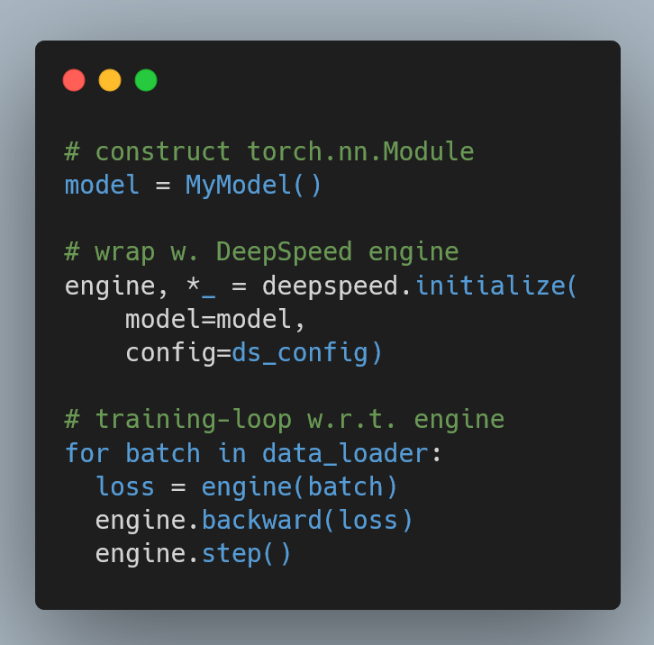
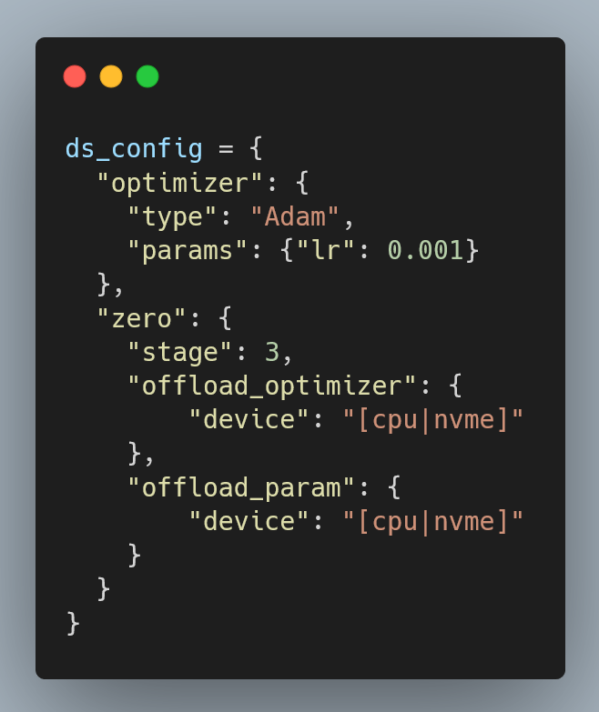
DeepSpeed/ZeRO Usability

Slide 11
ZeRO: Overview
 | Max Parameter (in billions) | Max Parallelism | Compute Efficiency | Usability (Model Rewrite)
Data Parallel (DP) | Approx. 1.2 | >1000 | Very Good | Great
Model Parallel (MP) | Approx. 20 | Approx. 16 | Good | Needs Model Rewrite
MP + DP | Approx. 20 | > 1000 | Good | Needs Model Rewrite
Pipeline Parallel (PP) | Approx. 100 | Approx. 128 | Very Good | Needs Model Rewrite
PP + DP | Approx. 100 | > 1000 | Very Good | Needs Model Rewrite
MP + PP + DP | > 1000 | > 1000 | Very Good | Needs Significant Model Rewrite
ZeRO | > 1000 | > 1000 | Very Good | Great
Model Scale
Support 200B
Towards 1 Trillion
Speed
Up to 10X faster
Scalability
Superlinear speedup
Usability
Few lines of code changes
Model Scale
1 Trillion parameters
Order-of-magnitude b
Speed
Up to 10X faster for over 25B models
Usability
Few lines of code change
Impact
Microsoft internal & external open source
*Mixed precision Adam on Cluster of DGX-2 with NVIDIA 32 GB V100 GPUs
Notes:
ZeRO provides a path to training models with trillion parameters. It runs up to 10x faster than model parallelism for large model sizes, and offers superlinear scalability as we increase the number of GPUs. And last but not least, it does not require data scientists to rewrite their models. ZeRO can be enabled with a few lines of code change offering data scantiest access to billions of parameters
..
..

Slide 12
Outline
Motivation
ZeRO capability overview
Understanding Memory Consumption
ZeRO-DP: ZeRO powered data parallelism
Evaluation
Notes:
Now before we describe how ZeRO works, lets first take a step back to look at the memory consumption in standard data parallel training

Slide 13
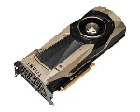
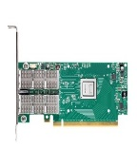

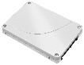
Distributed Data Parallel Training Overview
Mini-Batch
Intranode Interconnect
Intranode Interconnect
Forward Propagation
Model
Apply Updates
Loss
Updates
Internode Interconnect
Compute Optimizer Specific Updates
Backward
Propagation
Average Gradients
Intranode Interconnect
Intranode Interconnect
Data Parallel Training Loop
Distributed GPU Cluster
Notes:
During distributed DP, the training loop shown on left is executed on each GPU of a distributed GPU cluster shown on the right.
Each GPU runs the same loop but with a different mini-batch. The gradients computed by the backward propagation are averaged across all GPUs using an all-reduce.
Then this averaged gradients are used to update the weights in parallel.

Slide 14
Understanding Memory Consumption
Data₀
Transformer stack
Data₁
Transformer stack
GPU₀
GPU₁
= 1 layer
A 16-layer transformer model
*Mixed Precision Training (ICLR ‘18) with Adam Optimizer
Notes:
Now lets take a look at the memory consumption of each GPU in a data parallel training. Here we show a 16 layer transformer model being trained on 2 data parallel GPUs
Since the training loop is executed on all GPUs in parallel, each GPU must store a replicated copy of the model states. During mixed precision training, they include: …

Slide 15
Understanding Memory Consumption
Data₀
Transformer stack
Data₁
Transformer stack
GPU₀
GPU₁
Each cell represents GPU memory used by its corresponding transformer layer
*Mixed Precision Training (ICLR ‘18) with Adam Optimizer

Slide 16
Understanding Memory Consumption
Data₀
Transformer stack
Data₁
Transformer stack
FP16 Parameters
FP16 Parameters
GPU₀
GPU₁
FP16 parameter
*Mixed Precision Training (ICLR ‘18) with Adam Optimizer

Slide 17
Understanding Memory Consumption
Data₀
Transformer stack
Data₁
Transformer stack
FP16 Parameters
FP16 Parameters
FP16 Gradient
FP16 Gradient
GPU₀
GPU₁
FP16 parameter
FP16 Gradients
*Mixed Precision Training (ICLR ‘18) with Adam Optimizer

Slide 18
Understanding Memory Consumption
Data₀
Transformer stack
Data₁
Transformer stack
FP16 Parameters
FP16 Parameters
FP16 Gradient
FP16 Gradient
GPU₀
FP32 Gradient
GPU₁
FP32 Gradient
FP32 Variance
FP32 Variance
FP32 Momentum
FP32 Momentum
FP32 Parameters
FP32 Parameters
FP16 parameter
FP16 Gradients
FP32 Optimizer States
Gradients, Variance, Momentum, Parameters
*Mixed Precision Training (ICLR ‘18) with Adam Optimizer

Slide 19
Understanding Memory Consumption
Data₀
Transformer stack
Data₁
Transformer stack
FP16 Parameters
FP16 Parameters
FP16 Gradient
FP16 Gradient
GPU₀
FP32 Gradient
GPU₁
FP32 Gradient
FP32 Variance
FP32 Variance
FP32 Momentum
FP32 Momentum
FP32 Parameters
FP32 Parameters
FP16 parameter : 2M bytes
FP16 Gradients : 2M bytes
FP32 Optimizer States : 16M bytes
Gradients, Variance, Momentum, Parameters
M = number of parameters in the model
Example 1B parameter model -> 20GB/GPU
Memory consumption doesn’t include:
Input batch + activations
*Mixed Precision Training (ICLR ‘18) with Adam Optimizer

Slide 20
Outline
Motivation
ZeRO capability overview
Understanding Memory Consumption
ZeRO-DP: ZeRO powered data parallelism
Evaluation
Notes:
Let us now take a look at how ZeRO works.

Slide 21
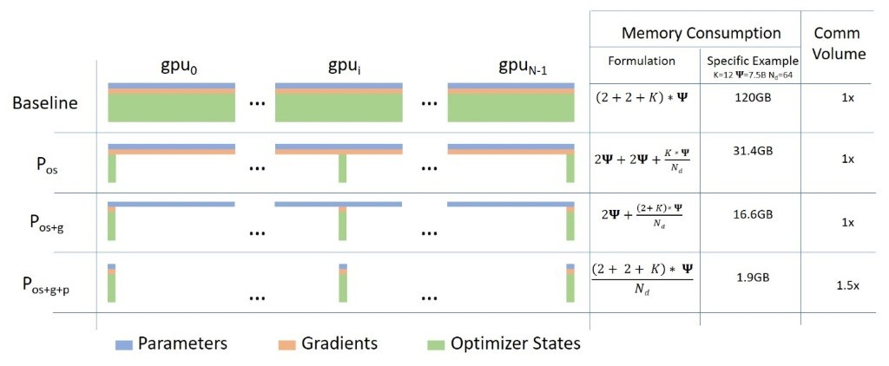
ZeRO-DP: ZeRO powered Data Parallelism
ZeRO removes the redundancy across data parallel process
Partitioning optimizer states, gradients and parameters (3 stages)
Notes:
As before, here we show the memory consumption during data parallel training..

Slide 22
ZeRO-DP: ZeRO powered Data Parallelism
ZeRO removes the redundancy across data parallel process
Partitioning optimizer states, gradients and parameters (3 stages)
Notes:
ZeRO reduces the memory footprint by partitioning the model states instead of replicating them.

Slide 23
ZeRO-DP: ZeRO powered Data Parallelism
ZeRO removes the redundancy across data parallel process
Partitioning optimizer states, gradients and parameters (3 stages)
Stage 1 (P_{os})
Compute gradients on different data
Average Gradients

Slide 24
ZeRO-DP: ZeRO powered Data Parallelism
ZeRO removes the redundancy across data parallel process
Partitioning optimizer states, gradients and parameters (3 stages)
Stage 2 (P_{os+g})
Compute gradients on different data
Average Gradients

Slide 25
ZeRO-DP: ZeRO powered Data Parallelism
ZeRO removes the redundancy across data parallel process
Partitioning optimizer states, gradients and parameters (3 stages)
Stage 3 (P_{os+g+p})
Compute gradients on different data
Average Gradients
Notes:
Stage 3
In the interest of time we will focus on how ZeRO stage 3 in detail since it is the most comprehensive of the three stages.

Slide 26
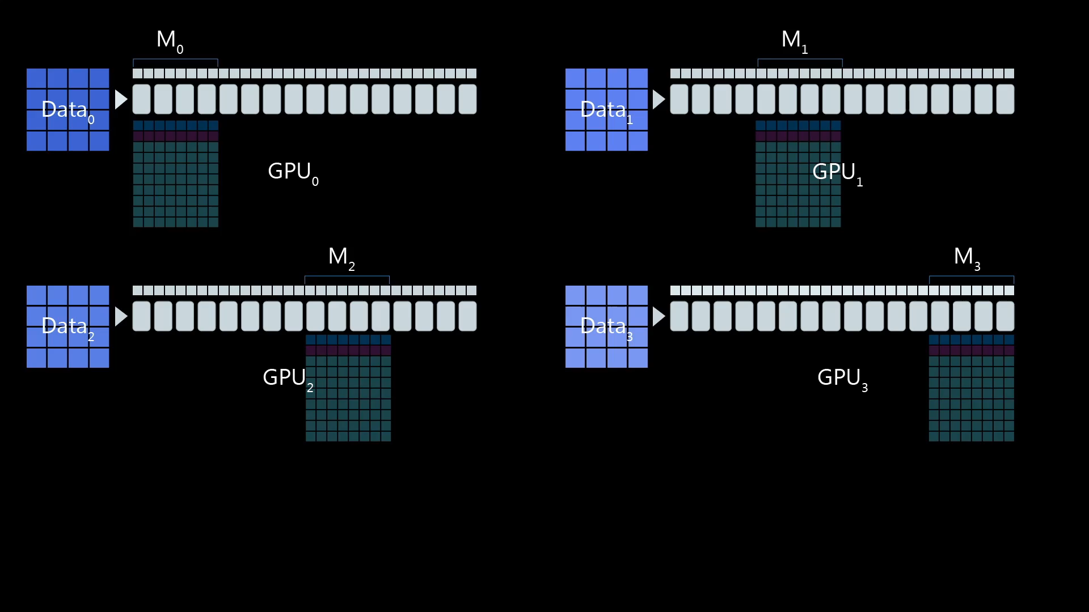
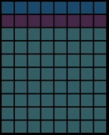
ZeRO-DP : Stage 3 Forward Propagation
fp16 params
fp16 grads
fp32 grads
fp32 momentum
fp32 variance
fp32 params
Notes:
The figure shows ZeRO Stage 3 on 4 data parallel GPUs. Notice that the model states are partitioned among the four GPUs.
To compute the forward pass on a layer of the model, the parameters for that layer must be broadcasted from the GPU that owns those layers.

Slide 27
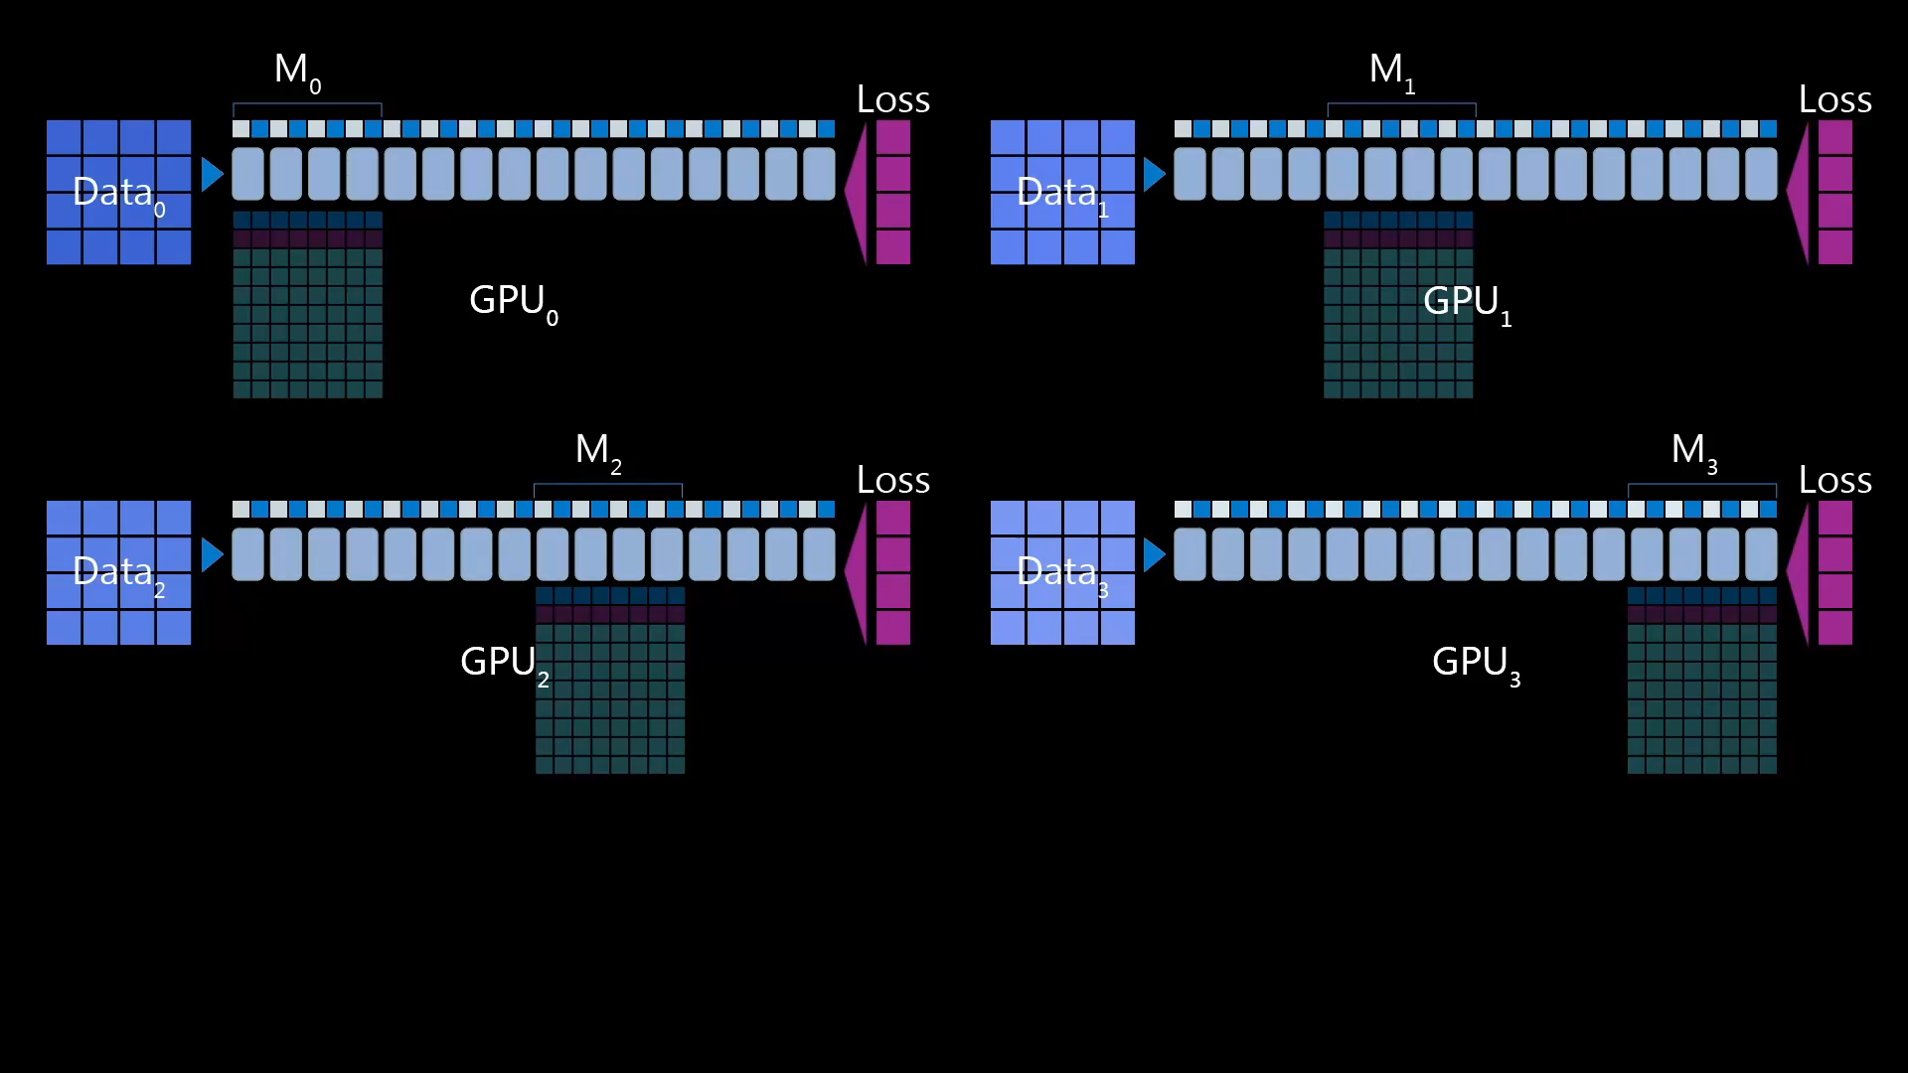
ZeRO-DP : Stage 3 Backward Propagation
fp16 params
fp16 grads
fp32 grads
fp32 momentum
fp32 variance
fp32 params
Notes:
Now in the backward propagation, the parameters must be broadcasted from the GPUs in the reverse order. In addition, once the gradient for a parameter is computed by the backward pass, it is averaged on the GPU that owns the corresponding parameter using a reduction.

Slide 28
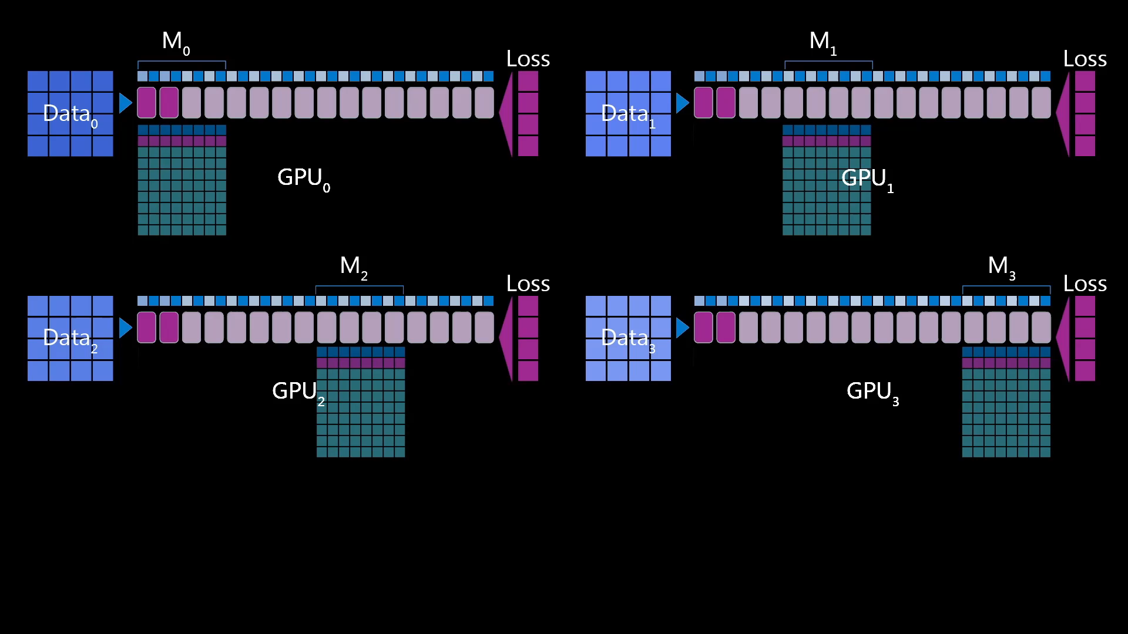
ZeRO-DP : Stage 3 Optimizer Step
fp16 params
fp16 grads
fp32 grads
fp32 momentum
fp32 variance
fp32 params
Notes:
Once the backward pass is completed, each GPU holds the averaged gradients for the parameters that it owns.

Slide 29
ZeRO-DP: Memory Savings
Progressive memory savings and Communication Volume
 | Memory Reduction with N GPUs | Max params with ZeRO only (in billions) | Max params with ZeRO and model parallelism (in billions) | Comm Volume
Data Parallel | 1x | 1.2 | 20 | 1x
ZeRO Stage 1 (P_{os}) | 4x | 6 | 100 | 1x
ZeRO Stage 2 (P_{os+g}) | 8x | 13 | 200 | 1x
ZeRO Stage 3 (P_{os+g+p}) | Nx | >1000 | >1000 | 1.5x
*Mixed precision Adam on Cluster of DGX-2 with NVIDIA 32 GB V100 GPUs
Notes:
Here, we look at the memory savings from ZeRO –DP in terms of the model states

Slide 30
ZeRO-DP: Memory Savings
Progressive memory savings and Communication Volume
 | Memory Reduction with N GPUs | Max params with ZeRO only (in billions) | Max params with ZeRO and model parallelism (in billions) | Comm Volume
Data Parallel | 1x | 1.2 | 20 | 1x
ZeRO Stage 1 (P_{os}) | 4x | 6 | 100 | 1x
ZeRO Stage 2 (P_{os+g}) | 8x | 13 | 200 | 1x
ZeRO Stage 3 (P_{os+g+p}) | Nx | >1000 | >1000 | 1.5x
*Mixed precision Adam on Cluster of DGX-2 with NVIDIA 32 GB V100 GPUs

Slide 31
ZeRO-DP: Memory Savings
Progressive memory savings and Communication Volume
 | Memory Reduction with N GPUs | Max params with ZeRO only (in billions) | Max params with ZeRO and model parallelism (in billions) | Comm Volume
Data Parallel | 1x | 1.2 | 20 | 1x
ZeRO Stage 1 (P_{os}) | 4x | 6 | 100 | 1x
ZeRO Stage 2 (P_{os+g}) | 8x | 13 | 200 | 1x
ZeRO Stage 3 (P_{os+g+p}) | Nx | >1000 | >1000 | 1.5x
*Mixed precision Adam on Cluster of DGX-2 with NVIDIA 32 GB V100 GPUs
Notes:
…
Now at this point, lets also take a look at the communication volume for ZeRO.

Slide 32
ZeRO-DP: Communication Volume
Progressive memory savings and Communication Volume
 | Memory Reduction with N GPUs | Max params with ZeRO only (in billions) | Max params with ZeRO and model parallelism (in billions) | Comm Volume
Data Parallel | 1x | 1.2 | 20 | 1x
ZeRO Stage 1 (P_{os}) | 4x | 6 | 100 | 1x
ZeRO Stage 2 (P_{os+g}) | 8x | 13 | 200 | 1x
ZeRO Stage 3 (P_{os+g+p}) | Nx | >1000 | >1000 | 1.5x
*Mixed precision Adam on Cluster of DGX-2 with NVIDIA 32 GB V100 GPUs

Slide 33
Outline
Motivation
ZeRO capability overview
Understanding Memory Consumption
ZeRO-DP: ZeRO powered data parallelism
Evaluation

Slide 34
ZeRO Implementation + Evaluation
Implementation
Python with PyTorch 1.2
Evaluation uses ZeRO-2 (P_{os+g})
ZeRO-3 (P_{os+g+p}) was released spring 2021
Baseline
With pure data-parallelism (DP)
PyTorch Distributed Data Parallel (DDP)
With DP + Model Parallelism (MP)
NVIDIA Megatron-LM¹
Intranode model parallelism
Warning: Spring 2020 was a long time ago!
¹ https://github.com/NVIDIA/Megatron-LM

Slide 35
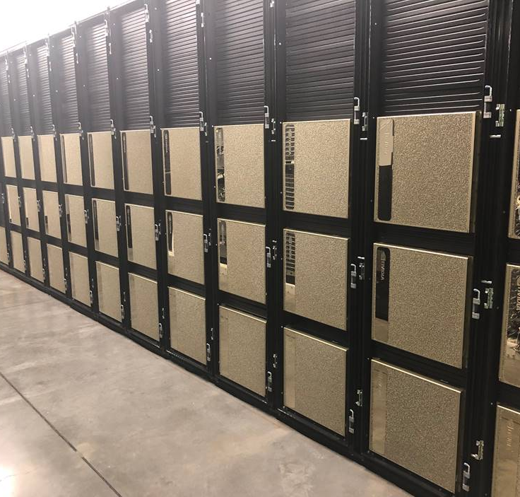
Hardware
NVIDIA DGX-2
16x NVIDIA V100-SXM3-32GB
Dual Intel Xeon Platinum 8168
1.5 TB system memory
8x 100 Gbps InfiniBand
25x NVIDIA DGX-2 nodes
400 V100 GPUs in total
648-port Mellanox CS7500 switch

Slide 36
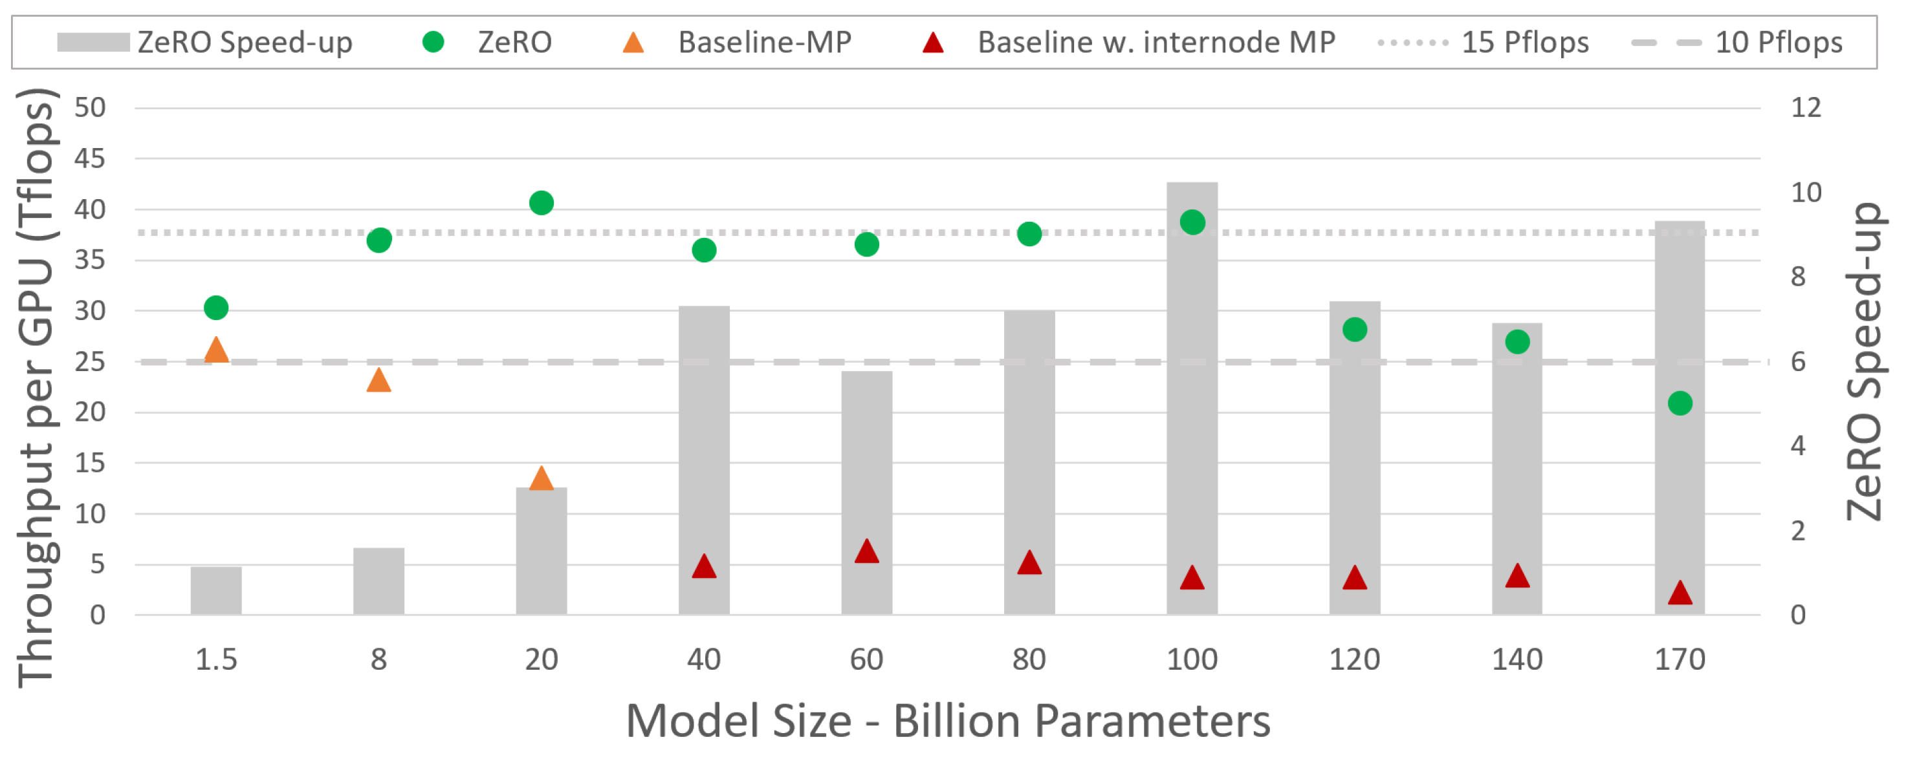
ZeRO Throughput Improvements
Notes:
* Our first evaluation looks at the performance of Zero with various model sizes between 1.5B and 170B on 400 gpus
* We see on our left y-axis
* We see on our right y-axis the relative speed-up of zero compared with our baseline
* The performance of Zero is shown in green dots
* The performance of baseline model parallelism in orange and red
* We observe our baseline perf starts to degrade after around 8B parameters
* In general we see over a 5x speed-up with ZeRO using models over 40B parameters
* We also see that in aggregate most model sizes were able to achieve between 10 and 15 Pflops
* The performance we see with these models can even increase further if we add additional GPUs due to super-linear properties we’ll see next

Slide 37
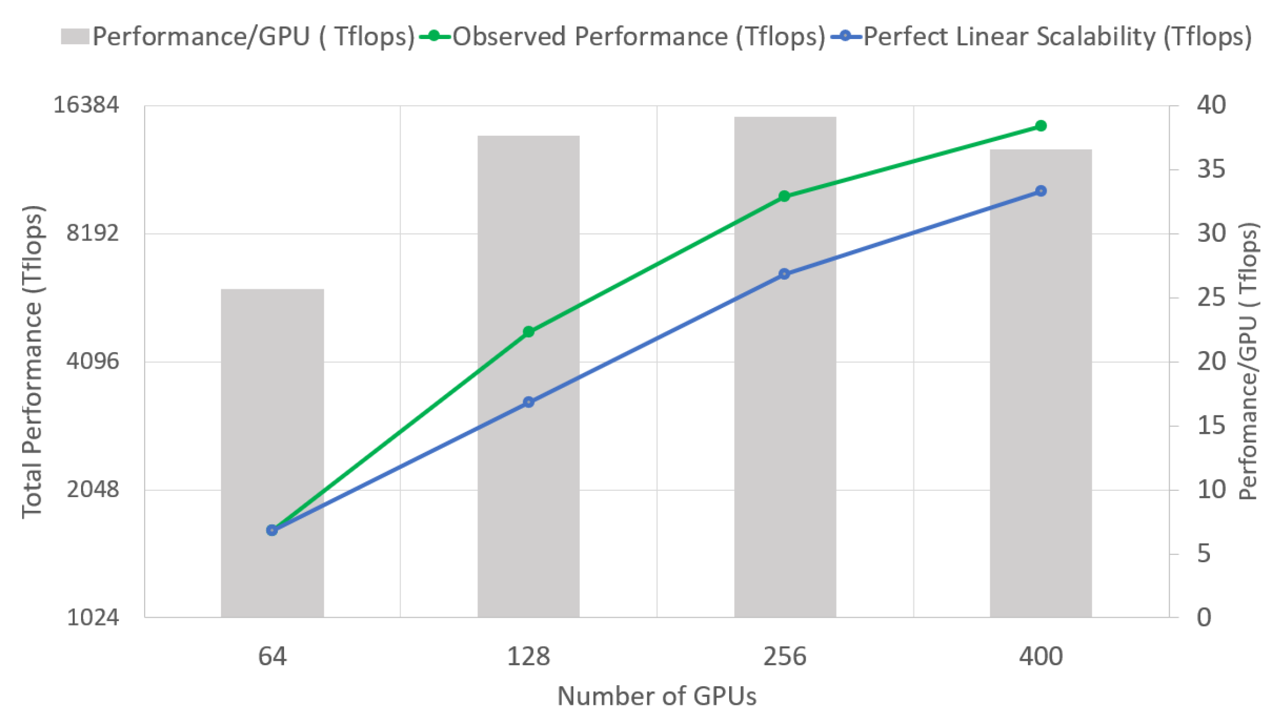
Superlinear speed-up
60B parameter model with increasing number of GPUs
Linear speed-up is usually best someone can do
ZeRO performance increases as data parallelism (DP) increases!
4x increase in GPUs
→ 6x increase in throughput
Memory overhead decreases with increase of DP
Results in more space for higher batch size
Notes:
* So ZeRO actually demonstrates super-linear scalability for large model sizes
* One way we can show this is by fixing the model size and increasing the number of GPUs used by DP
* Typically a linear speed-up...
(4x increase) 64 gpus -> 256 gpus
1,644 total Tflops (64 gpus)
10,009 total Tflops (256 gpus)
Not strong/weak scaling
See section X.C in the paper for details. Should reference bsz concerns verbally

Slide 38
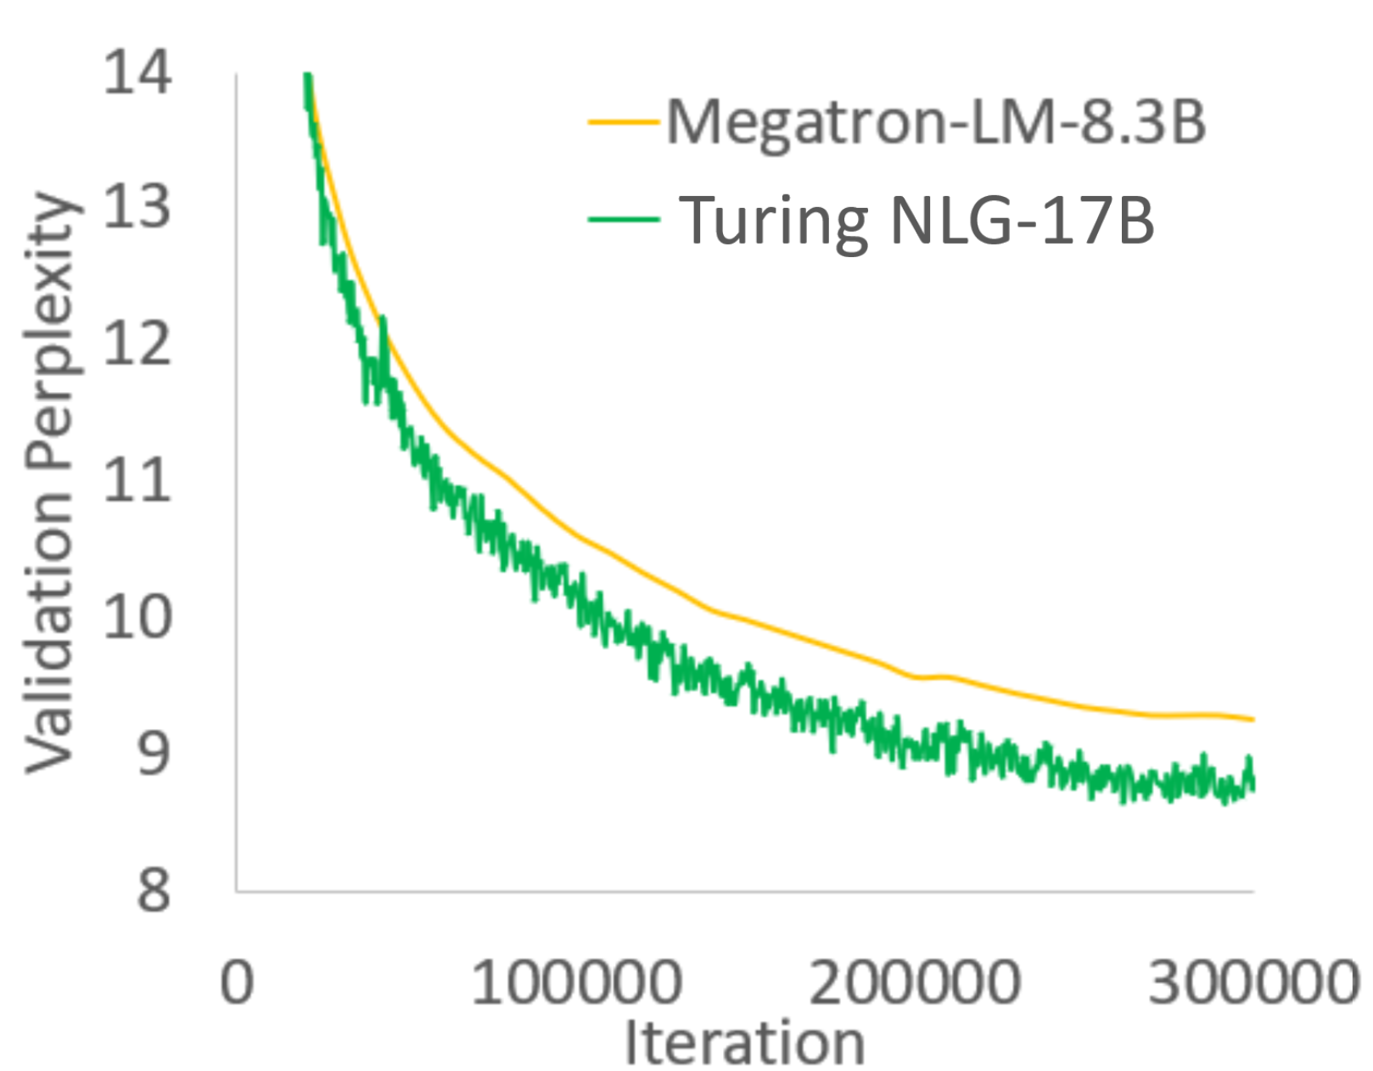
Turing-NLG 17B Training
Largest model at time of release
New SOTA on Webtext-103
Perplexity of 10.21
300k training iterations
ZeRO stage 1 (P_{OS})
Sustained throughput of 41+ TFlops/GPU using 256 GPUs
Notes:
* At time of release last spring, the Turing-NLG 17B model was the largest language model
* Achieved state of the art on the webtext task
* This model was trained alongside the Turing team at Microsoft using ZeRO stage 1 and achieved a throughput of over 41 Tflops

Slide 39



ZeRO-Offload: Democratizing Billion-Scale Model Training
Jie Ren
*
†
†
†
Samyam Rajbhandari
Reza Yazdani Aminabadi
Olatunji Ruwase
*
†
*
†
Shuangyan Yang
Minjia Zhang
Dong Li
Yuxiong He
*
†
UC Merced
Microsoft
Notes:
This work is done

Slide 40
Billon-Scale Model Training - Scale Out Large Model Training
Model parallelism (Megatron-LM)
Partition the model states vertically across multiple GPUs.
Pipeline parallelism (PipeDream, SOSP’19)
Partition the model states horizontally across layers.
ZeRO: Zero Redundancy Optimizer (ZeRO, SC’20)
Split the training batch across multiple GPUs without model states duplication.
Internode Interconnect
Internode Interconnect
Intranode Interconnect
Internode Interconnect
Internode Interconnect
Distributed GPU Cluster

Slide 41
Billon-Scale Model Training - Scale Out Large Model Training
Model parallelism (Megatron-LM)
Partition the model states vertically across multiple GPUs.
Pipeline parallelism (PipeDream, SOSP’19)
Partition the model states horizontally across layers.
ZeRO: Zero Redundancy Optimizer (ZeRO, SC’19)
Split the training batch across multiple GPUs without model states duplication.
Internode Interconnect
Internode Interconnect
Require multiple GPUs resources
Intranode Interconnect
Internode Interconnect
Internode Interconnect
Distributed GPU Cluster

Slide 42
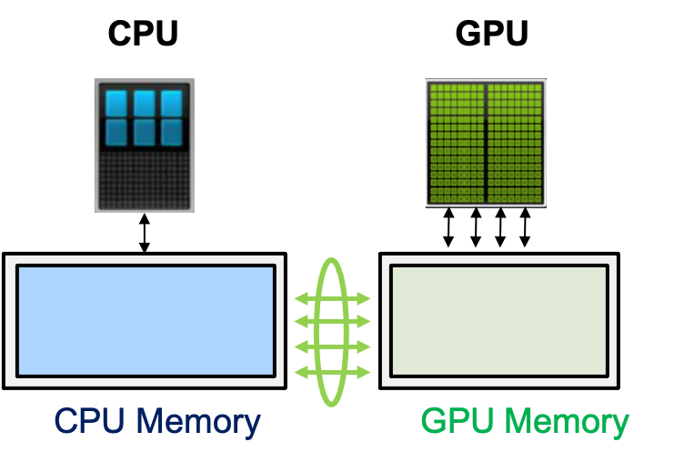
Billon-Scale Model Training - Scale Up Large Model Training
Sacrifice scalability
Size: ~100s GB/sec
BW: ~100s GB/sec
Size: ~10s GB
BW: ~500s GB/sec
~10s GB/sec
Notes:
TODO: add animation w. bubble

Slide 43
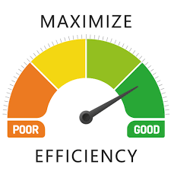


ZeRO-Offload: Democratizing Billion-Scale Model Training
Efficiency
Scalability
Usability
Enable 13B parameters model training on a single NVIDIA V100 GPU at 40 TFLOPS.
Achieve near perfect linear speedup with multiple GPUs.
Require no model refactoring.
Notes:
We introduce ZeRO-Offload, a novel heterogeneous DL training technology that enables training of multi-billion parameter models on a single GPU without any model refactoring.
ZeRO-Offload is designed around three main pillars: i)Efficiency, ii) Scalabilty, and iii) Usability.
ZerO-Offload enables to train 13 billion param model on a single NVIDIA V100 GPU at 40 TFLOPS.
Working with ZeRO powered data parallelism, ZeRO-Offload achieves near perfect linear speedup with multiple GPUs.
ZeRO-Offload is available as part of an open-source PyTorch library and does not require model refactoring to work.

Slide 44
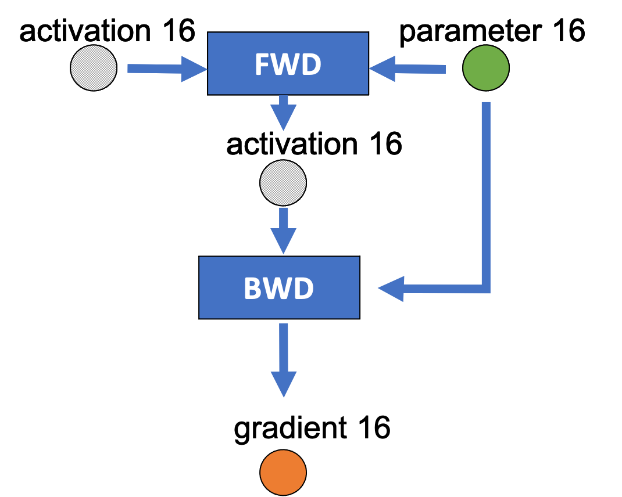
Mixed-precision Training
Mixed precision training iteration for a layer.
Notes:
Before dig into the details of offload strategy used in zero-offload, let’s review of mixed precision training
Mixed precision training offers significant computational speedup by performing operations in half-precision format
The graph shows the dataflow of mixed precision training, where the circular nodes represents model states (parameter16,gradient16, parameter32, momentum32, variance32), and the rectangular nodes represents computation (forward, backward,param update)
. In each training step, an FP16 copy of the parameters used in the forward and backward pass

Slide 45
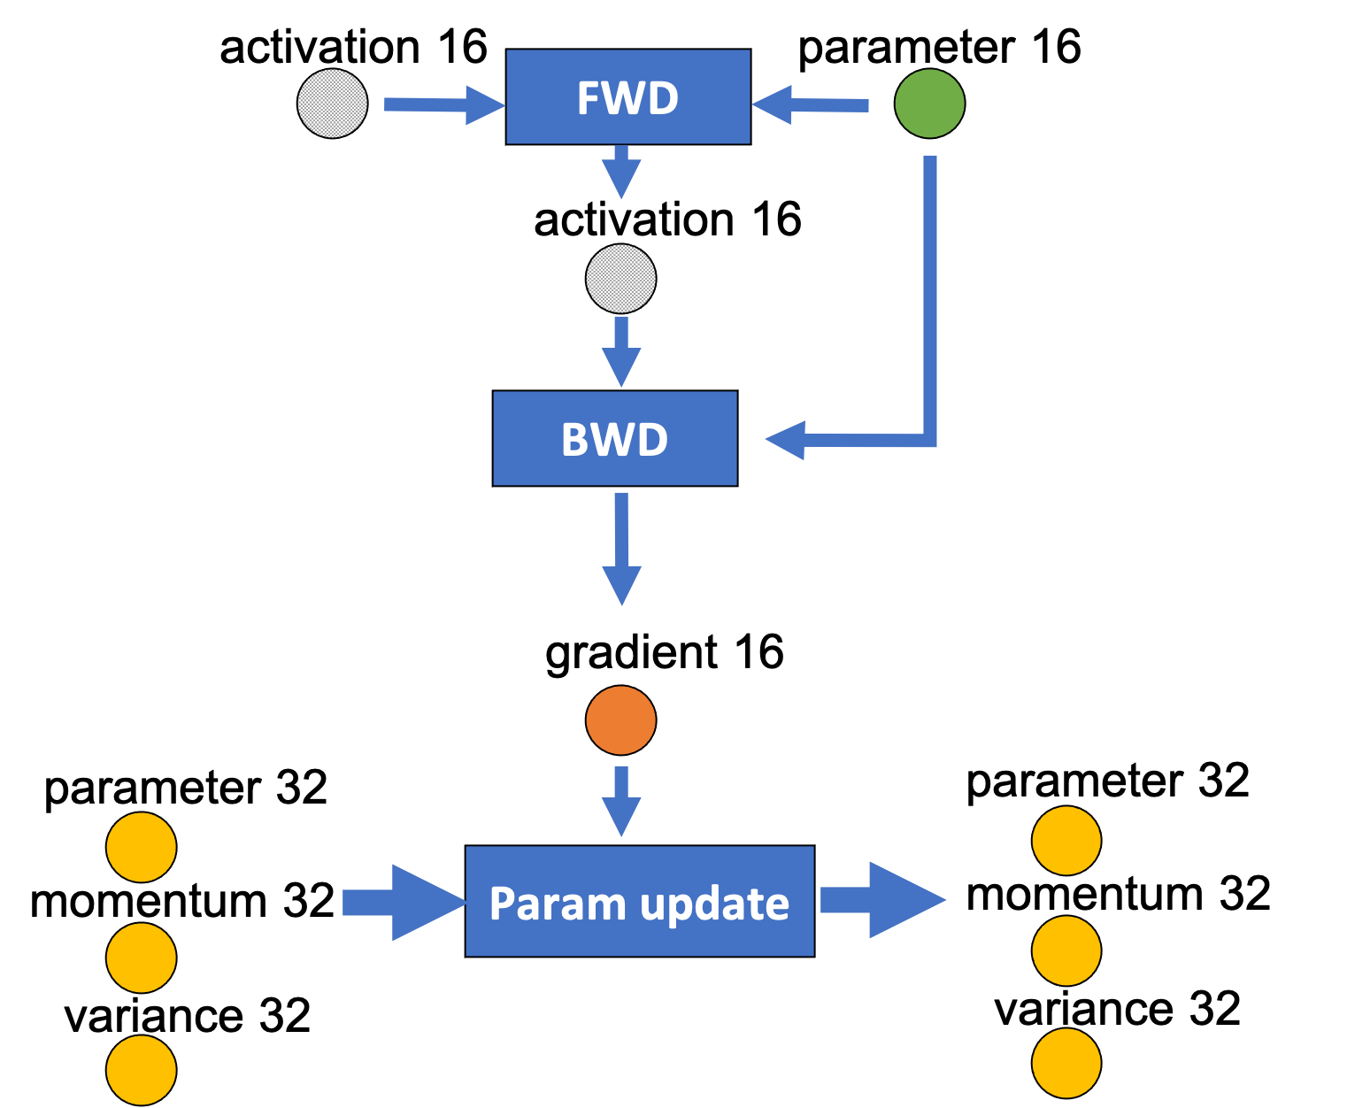
Mixed-precision Training
Mixed precision training iteration for a layer.
Notes:
In order to match the accuracy of the FP32 networks, an FP32 master copy of parameters and optimizer states such as momentum and variance is maintained and updated with the gradient during the optimizer step

Slide 46
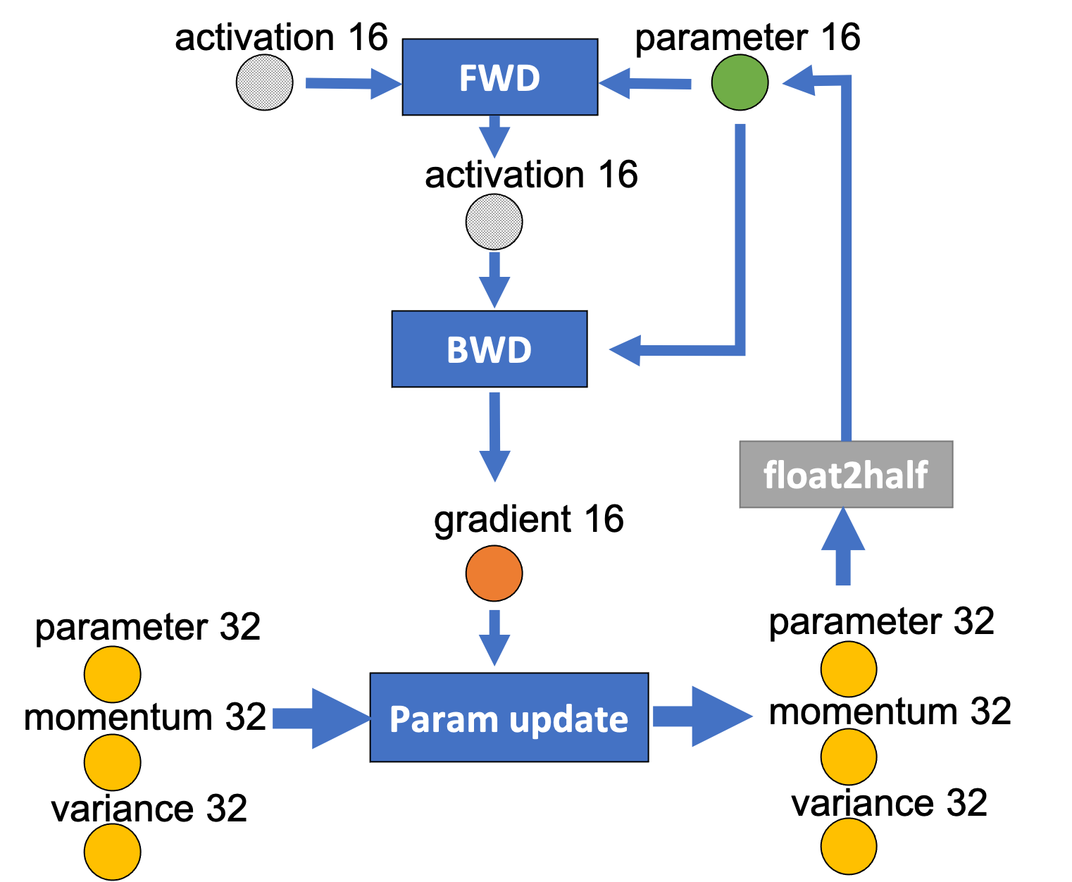
Mixed-precision training
Mixed precision training iteration for a layer.
Notes:
At the end of the training step, FP16 parameters is updated based on FP32 master copy of parameters

Slide 47
Offload Strategy
ZeRO-Offload partitions the dataflow graph with:
Few computation on CPU
Minimize of communication volume
Maximize memory saving while achieving minimum communication volume
Notes:
:1.ZeRO-offload requires orders-of-magnitude fewer computation on CPU compared to GPU, which prevents CPU from becoming a performance bottleneck.
2. ZeRO-Offload guarantees the minimization of communication volume between CPU and GPU memory.
3. maximize the memory savings while achieving minimum communication volume

Slide 48
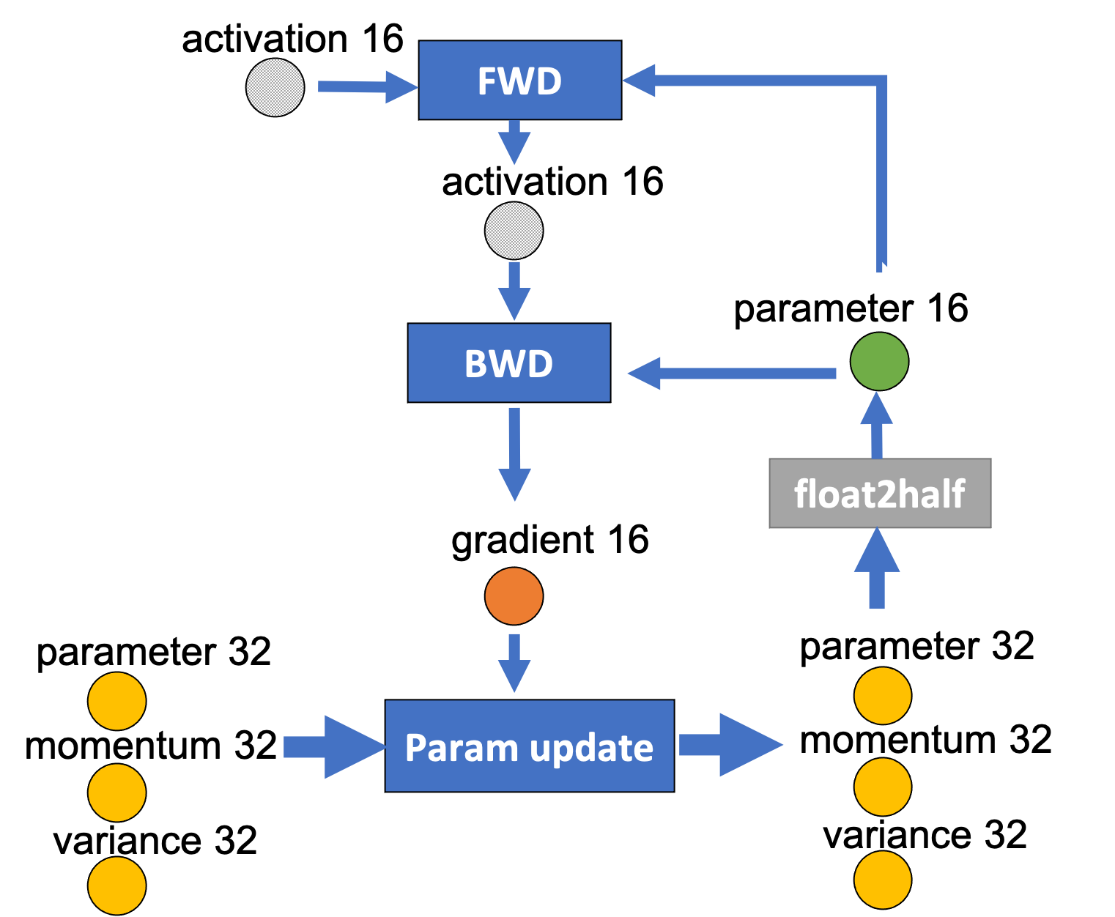
Offload Strategy
O(MB)
M: model param count
B: batch size
O(MB)
Computational Complexity
O (MB)
O(M)
The dataflow of fully connected neural networks with M parameters.
Notes:
We analysis the Computational complexity of DL training. .
The compute complexity of DL training per iteration is generally given by O(MB), where M is the model size and B is the effective batch size
the forward propagation and backwardpropagation both of which have a compute complexity of O(MB), which mush be done on GPU
parameter updates etc that have acomplexity ofO(M)may be offloaded to CPU

Slide 49

Offload Strategy
The dataflow of fully connected neural networks with M parameters.
Notes:
We futher analysis the data volume in bytes that flows through nodes during an iteration.
For a model with M parameters, the data volume in this graph is either 2M where the source node produces fp16 model states, or4M where the source node produces fp32 model states.
any partitioning of this graph would require cutting at least two edges, each of which has a edge weight of at least2M, resulting in a total communication of at least 4M

Slide 50
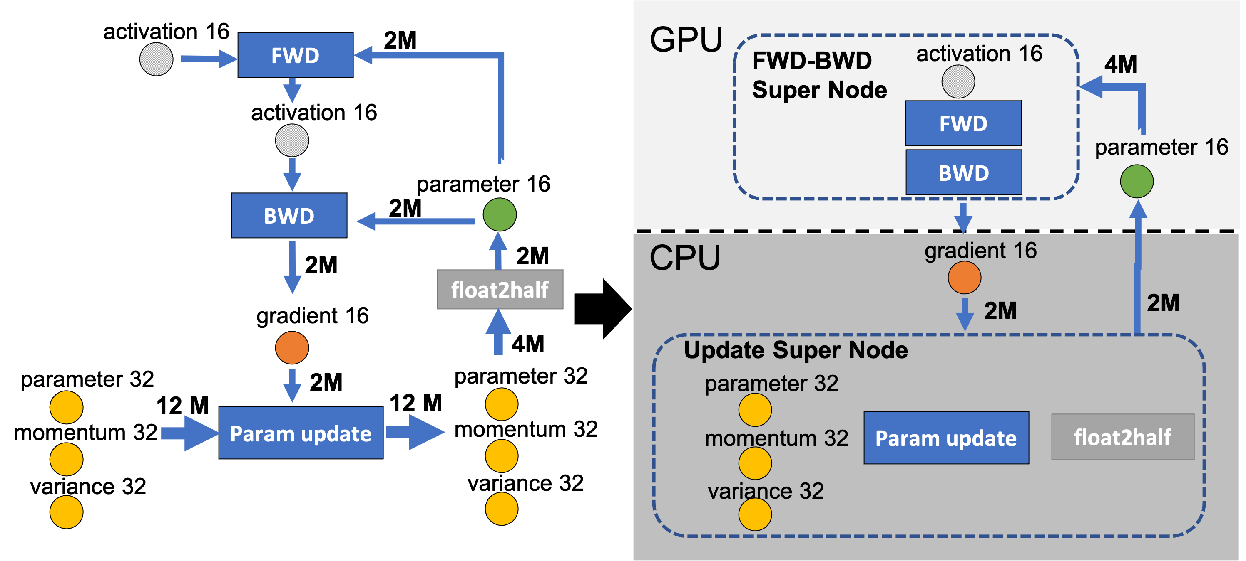
ZeRO-Offload enables large model training by offloading data and compute to CPU
Offloading fp16 gradients and Update Super Node to CPU
Notes:
To achieve few computation happens on CPU and minimize the computation volume,
We choose to offload fp16 gradients, the fp32 model states (momentum32, variance32 and parameter32) , the Param Update and thefloat2half computation to CPU.

Slide 51
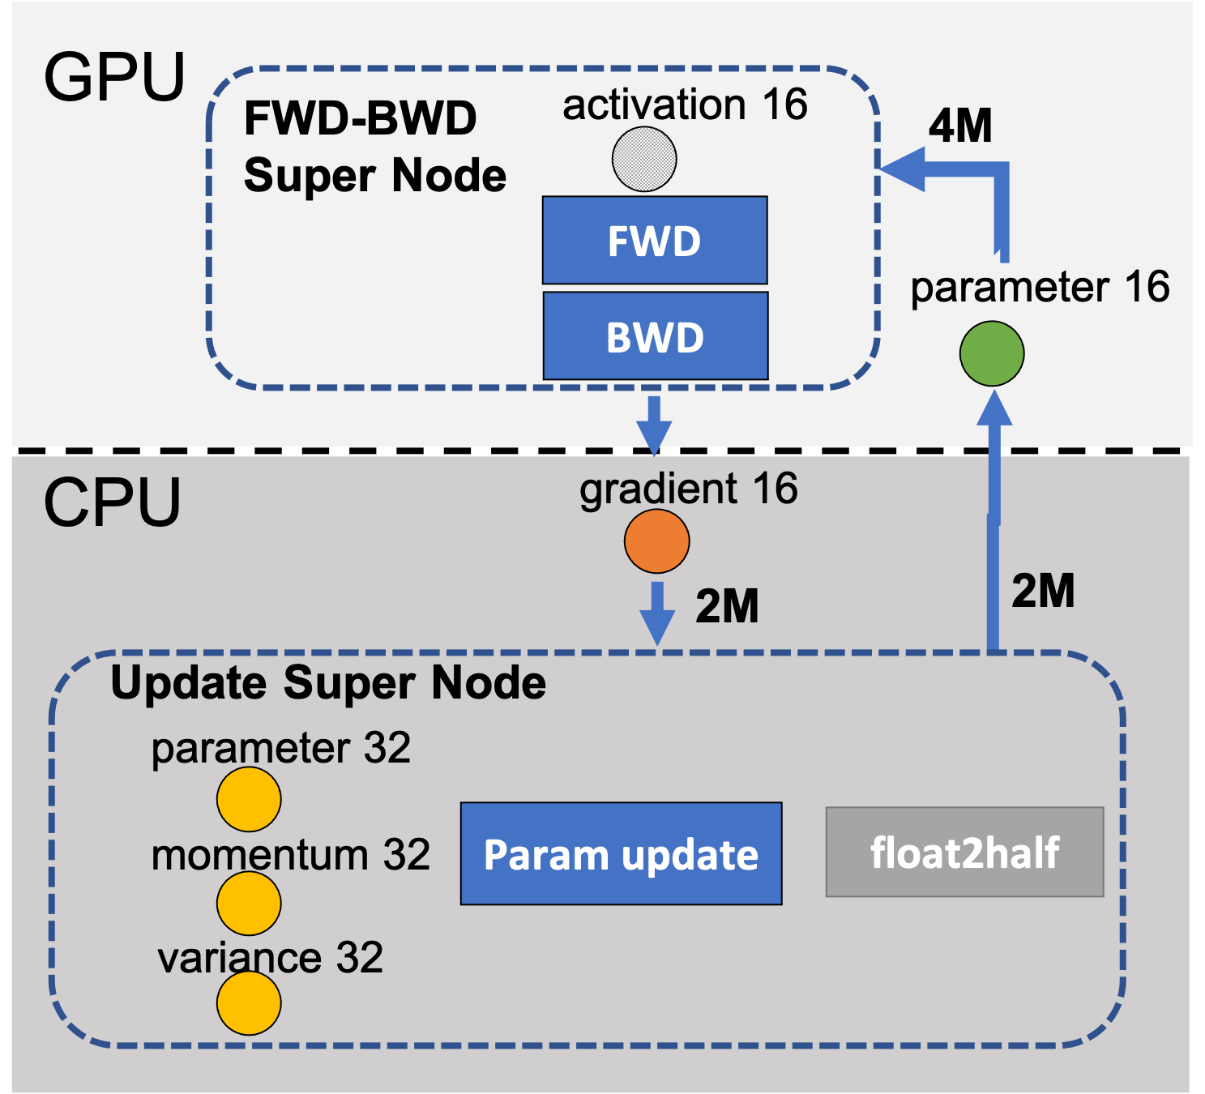
Unique Optimal Offload Strategy
FWD-BWD | param16 | gradient16 | Update | Memory | Reduction
GPU | GPU | GPU | GPU | 16M | 1x(baseline)
GPU | GPU | CPU | GPU | 14M | 1.14x
GPU | GPU | GPU | CPU | 4M | 4x
GPU | GPU | CPU | CPU | 2M | 8x
Memory savings for offload strategies that minimize communication volume compared to the baseline.
Notes:
We futher verify that the offload strategy in ZeRO-offload Maximize memory saving while achieving minimum communication volume
The tables shows the memory savings of all valid partitioning strategies that minimize the communication volume.
The max-imum memory savings of 8x can be achieved by using ZeRO-Offload strategy

Slide 52
ZeRO-Offload Single GPU Schedule
Step i
time
FWD & BWD
GPU
Computation stream:
ZeRO-Offload training process on a single GPU.
Notes:
The training process of ZeRO-Offload on a single GPU is as follows
Forward propagation computes the loss without CPU communication.

Slide 53
ZeRO-Offload Single GPU Schedule
Step i
time
FWD & BWD
GPU
Computation stream:
GPU->CPU
Swapping stream:
gradient offload
ZeRO-Offload training process on a single GPU.
Notes:
During the backward propagation on the loss, ZeRO-Offload transfers gradients for each parameter in small groups to the CPU memory immediately after they are computed.

Slide 54
ZeRO-Offload Single GPU Schedule
Step i
time
FWD & BWD
param update
GPU
CPU
Computation stream:
GPU->CPU
CPU->GPU
Swapping stream:
gradient offload
param swap
ZeRO-Offload training process on a single GPU.
Notes:
ZeRO-Offload updates the fp32 parameters and the remaining optimizer states directly on CPU, and copies the updated fp32 parameters from the CPU memory to the fp16 parameters on the GPU memory asynchronously.

Slide 55
ZeRO-Offload Single GPU Schedule
Step i
Step i+1
time
FWD & BWD
FWD & BWD
param update
GPU
CPU
GPU
Computation stream:
GPU->CPU
CPU->GPU
Swapping stream:
gradient offload
param swap
ZeRO-Offload training process on a single GPU.
See paper for Multi-GPU Schedule
Notes:
ZeRO-Offload starts computation for next step on GPU when the updated fp32 parameters copy to the fp16 parameters on the GPU memory finshed.

Slide 56
Optimized CPU Execution
Highly parallelized CPU optimizer implementation
SIMD vector instruction for fully exploiting the hardware parallelism supported on CPU architectures.
Loop unrolling to increase instruction level parallelism.
OMP multithreading for effective utilization of multiple cores and threads on the CPU in parallel.
 | Adam Optimizer: Parameter Update Latency (seconds)
Model Size (B) | PyTorch-CPU | DeepSpeed-CPU | PyTorch-GPU
1 | 1.39 | 0.22 | 0.10
2 | 2.75 | 0.51 | 0.26
4 | 5.71 | 1.03 | 0.64
8 | 11.93 | 2.41 | 0.87
10 | 14.00 | 2.57 | 1.00

Slide 57
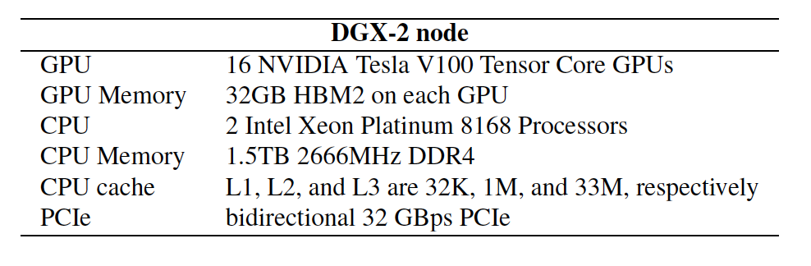
Evaluation
Testbed
Baselines
Pytorch DDP: distributed data parallelism
Megatron: model parallelism
ZeRO: extended data parallelism by eliminating memory redundancies across multiple GPUs

Slide 58
Model Scale
ZeRO-Offload enables 13B model training on a single GPU, and easily enables training of up to 70B parameter with 16 GPUs.
Notes:
TODO: redo plot dropping L2L

Slide 59
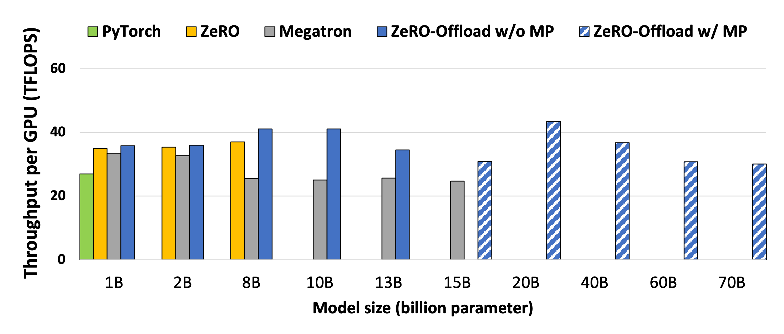
Training Throughput – Multiple GPUs
For 1B to 15B models, ZeRO-Offload achieves the highest
throughput compared with PyTorch, ZeRO, and Megatron.
Single DGX-2 node (x16 V100-32GB)
Notes:
We exclude
L2L [29] in this test because its implementation does not
support multi-GPU training.
since ZeRO-Offload can train with larger micro-batch sizes and gives higher throughput

Slide 60
Training Throughput – Multiple GPUs
Combined with model parallelism, ZeRO-Offload enables training up to 70B parameter models with more than 30 TFLOPS throughput per GPU.
Single DGX-2 node (x16 V100-32GB)
Notes:
We exclude
L2L [29] in this test because its implementation does not
support multi-GPU training.

Slide 61
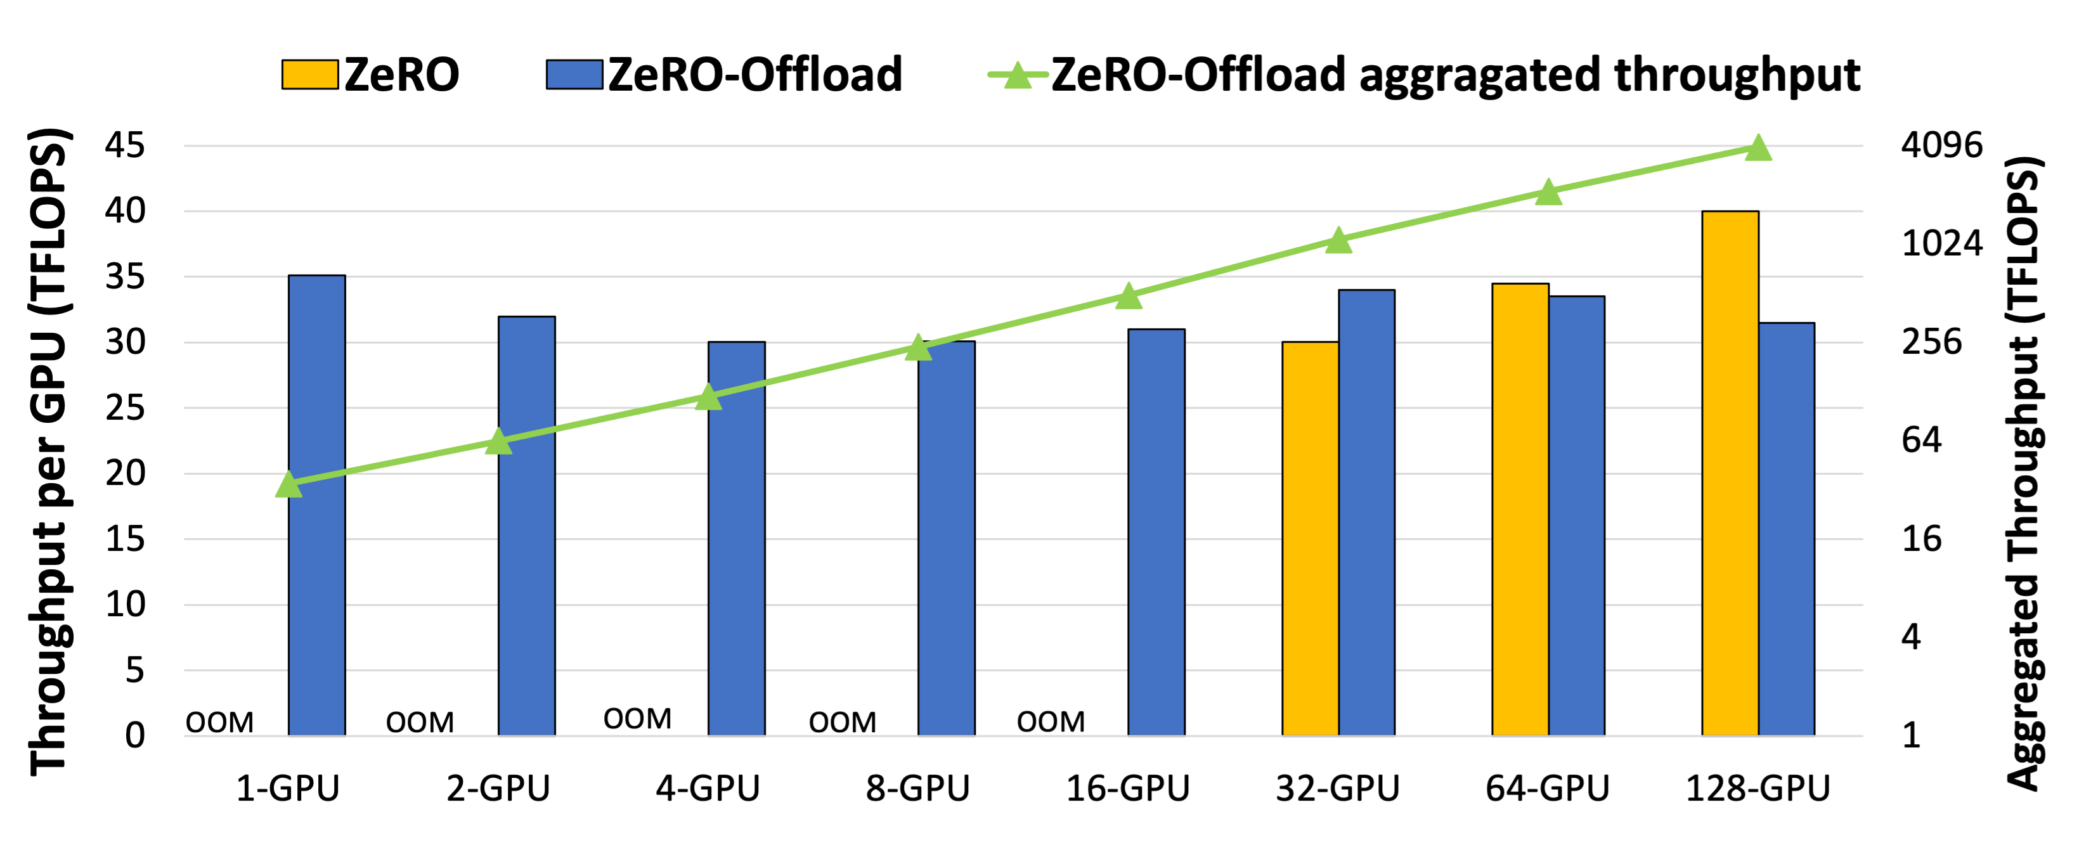
Throughput Scalability
ZeRO-Offload achieves near perfect linear speedup in terms of aggregated throughput running at over 30 TFlops per GPU.

Slide 62
Summary
ZeRO-Offload is a powerful GPU-CPU hybrid DL training technology with high compute efficiency and near linear throughput scalability.
ZeRO-Offload allows data scientists to train models with multi-billion parameter models even on a single GPU, without requiring any model refactoring.
Bottlenecks are now:
CPU memory limitations
Parameter count per GPU
Performance limited by single PCIe link

Slide 63



ZeRO-Infinity:
Breaking the GPU Memory Wall for Extreme Scale Deep Learning
Samyam Rajbhandari, Olatunji Ruwase, Jeff Rasley, Shaden Smith, Yuxiong He
deepspeed

Slide 64
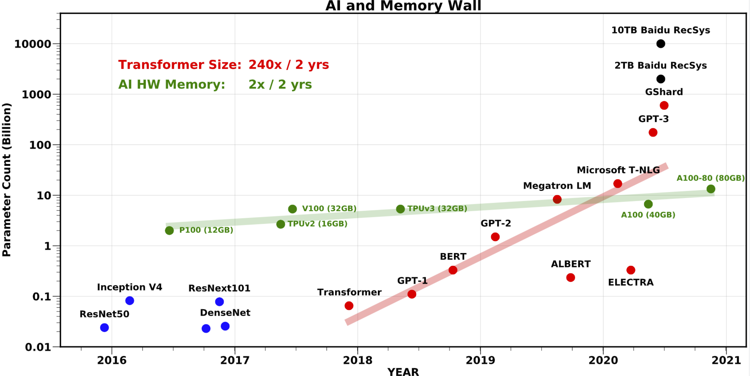
Large model training landscape
GPU Memory Wall
1T (10T) params: 800 (8K) V100 GPUs
How do we support the growth in model size?
Accessibility to large model training
256 GPUs to fine-tune GPT-3
Limited access to such resources
Model code refactoring
Re-writing the model using 3D parallelism (tensor-slicing + pipeline parallelism)
Painful and error prone
*AI and Memory Wall. (This blogpost has been written in… | by Amir Gholami | riselab | Medium
Notes:
In the last two years, model sizes have increased by 240x while the amount of GPU memory has increased by merely 2x. It is no longer possible to fit large models on a single GPU device and DL training systems have evolved to combine multiple forms of parallelism such as tensor-slicing, pipeline parallelism and ZeRO to leverage aggregate GPU memory in a cluster to support training these large models.
Given this large model training landscape, three questions arises:
How do we sustain the growth in model size, when the aggregate device memory is no longer sufficient to fit large models for training?
Once large models are trained, how do we make them more accessible for fine-tuning?
Existing technology like 3D parallelism that uses tensor-slicing and pipeline parallelism requires major core refactoring which is error prone and painful. Is there a way to simply the pipeline for data scientist for large model training?
In the next slides I will talk about how we can address these challenges with ZeRO-Infinity. Let us at the GPU Memory wall

Slide 65
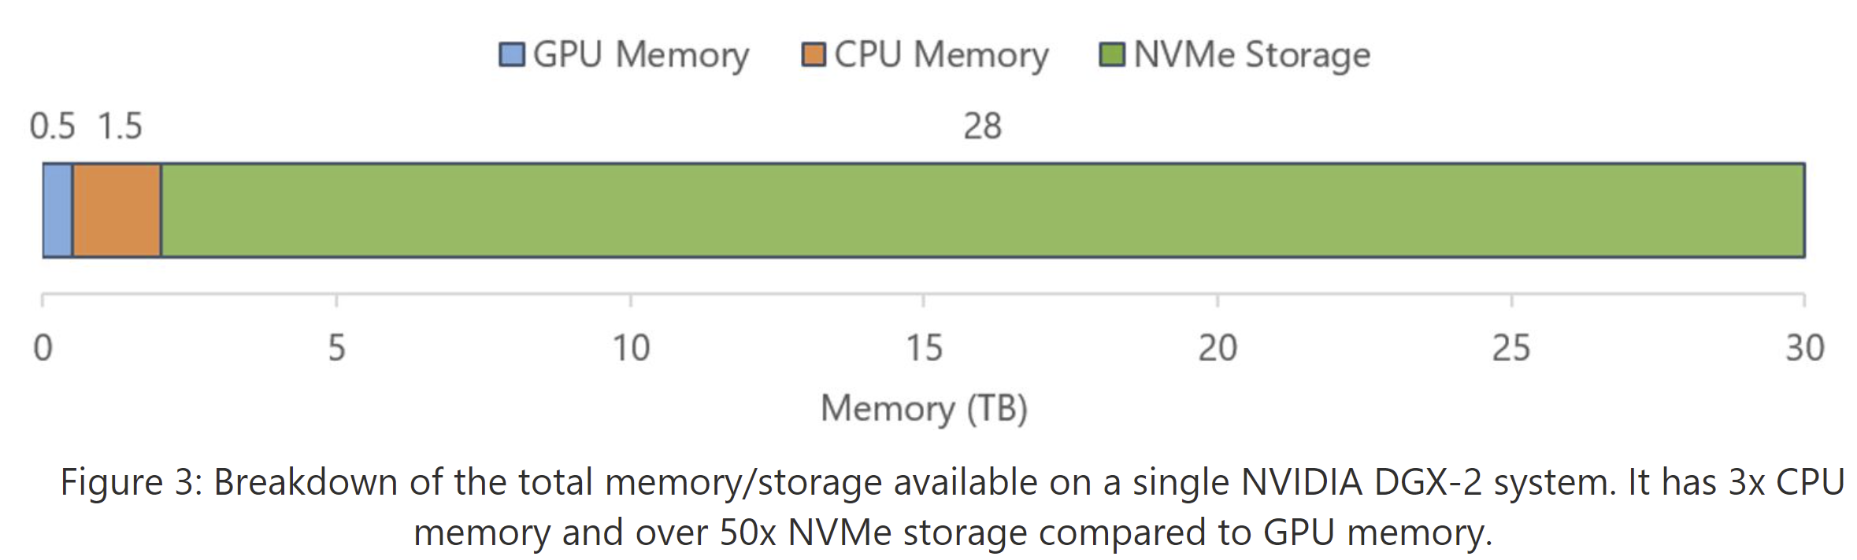
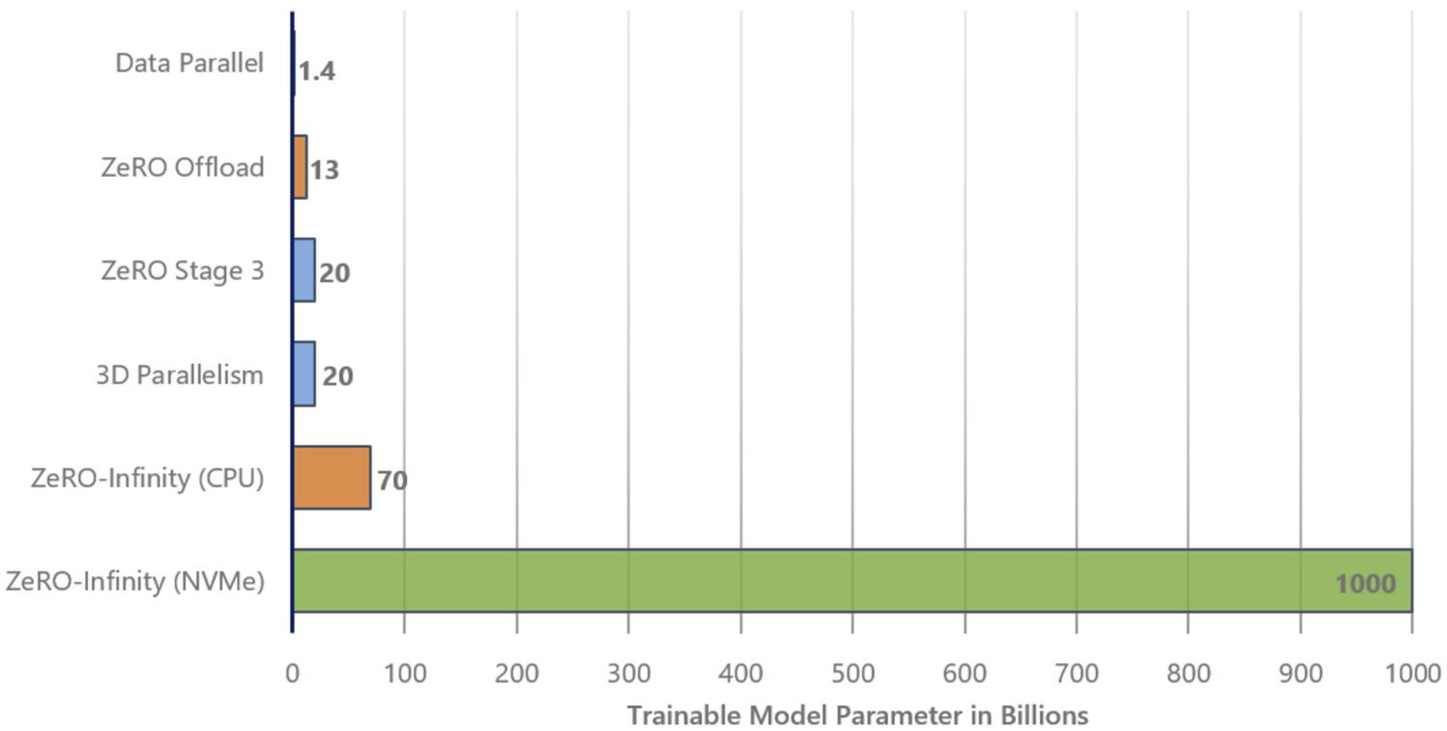
Beyond the GPU Memory
Memory available on a Single DGX-2 Node
Modern clusters have heterogeneous memory systems.
GPU memory comprises a small fraction
Leverages GPU/CPU/NVMe memory
32T params on 32 nodes
1T params on a single node
GPT-3 can be fine-tuned on a single node
Model Size on a Single DGX-2 Node
GPU Only
CPU + GPU
NVMe+CPU+GPU
Notes:
Actually, Modern clusters like the NVIDIA DGX-2 superpod have heterogeneous memory systems, where the aggregate GPU accounts for less than 2% of total storage/memory in the system.
From a memory perspective, a single DGX-2 node can support training a 20 billion parameter model with GPU only memory, but if we can leverage the available CPU and NVMe memory, it could support training a trillion parmaeter model.
A model like GPT-3 could be fine-tuned on a single node.

Slide 66
How to leverage non-GPU memory?
Can we extend an existing parallel training technology to use CPU/NVMe memory?
Data Parallelism : Replication causes memory explosion
Tensor-Slicing: Does not scale beyond a single node
Pipeline-Parallelism: Requires significant code refactoring
What about Zero Redundancy Optimizer (ZeRO)?
Efficiently scale across nodes – trillions of parameters
No model code refactoring necessary
Notes:
So how can we leverage non-GPU memory? Can we simply extend existing parallel technology to leverage CPU/NVME Memory? Lets take a look at our candidates:
Data parallelism replicated data across devices and is thus causes memory explosion due to redundancy
Tensor Slicing cannot scale beyond a single node even with data on GPU memory due to communication overhead
Pipeline parallelism can scale across nodes and offers great efficiency, but it also requires significant model code refactoring that defeats our goal to simplify large model training
But what about the ZeRO redundancy Optimizer?
It can not only scale efficiently across nodes to support trillions of parameters, but also does not require any model code refactoring. So ZeRO seems like a promising candidate. Lets do a quick recap of how it works

Slide 67
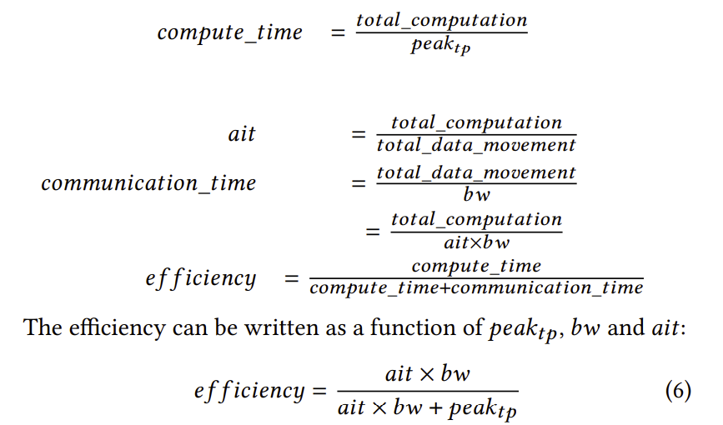
ZeRO with CPU/NVME Offload
ZeRO-Offload limitations
Does not partition or offload parameters
Parameter count per GPU
ZeRO-3 + Offload all model states
Store in CPU/NVME instead of GPU
Send from CPU/NVMe to GPU
Broadcast or reduce as ZeRO
Is NVME←→ GPU bandwidth sufficient?
Efficiency analysis based on
bandwidth
Notes:
So how can we extend ZeRO to use non-GPU memory? Can we by simply offload the model states to CPU/NVMe memory and move them to GPU only when they are needed.
In theory this would take us beyond the GPU memory wall, but to be practically useful, it is also necessary for the system to achieve good training efficiency or thoughput. To understand the impact of this offloading strategy on throughput we perform an analysis that measures the impact of the bandwidth between GPU and NVME/CPU memory on efficiency.
For our analysis, we define a simple efficiency metric as the ratio between compute time and compute and communication time.
The compute time is estimated as a function of total computation during each iteration of training, and peak achievable thoughput achievable in the absence of any communication.
The communication time is estimated as a function of total data movement and the slowest data movement bandwidth in the critical part.
We can re-write the total data movement as a function total_computation and arithmetic intensity wrt to different data used in the training, and obtain efficiency as a function of the data type, communication bandwidth, achievable peak throughput and arithmetic intensity for a given set of model and training parameters

Slide 68
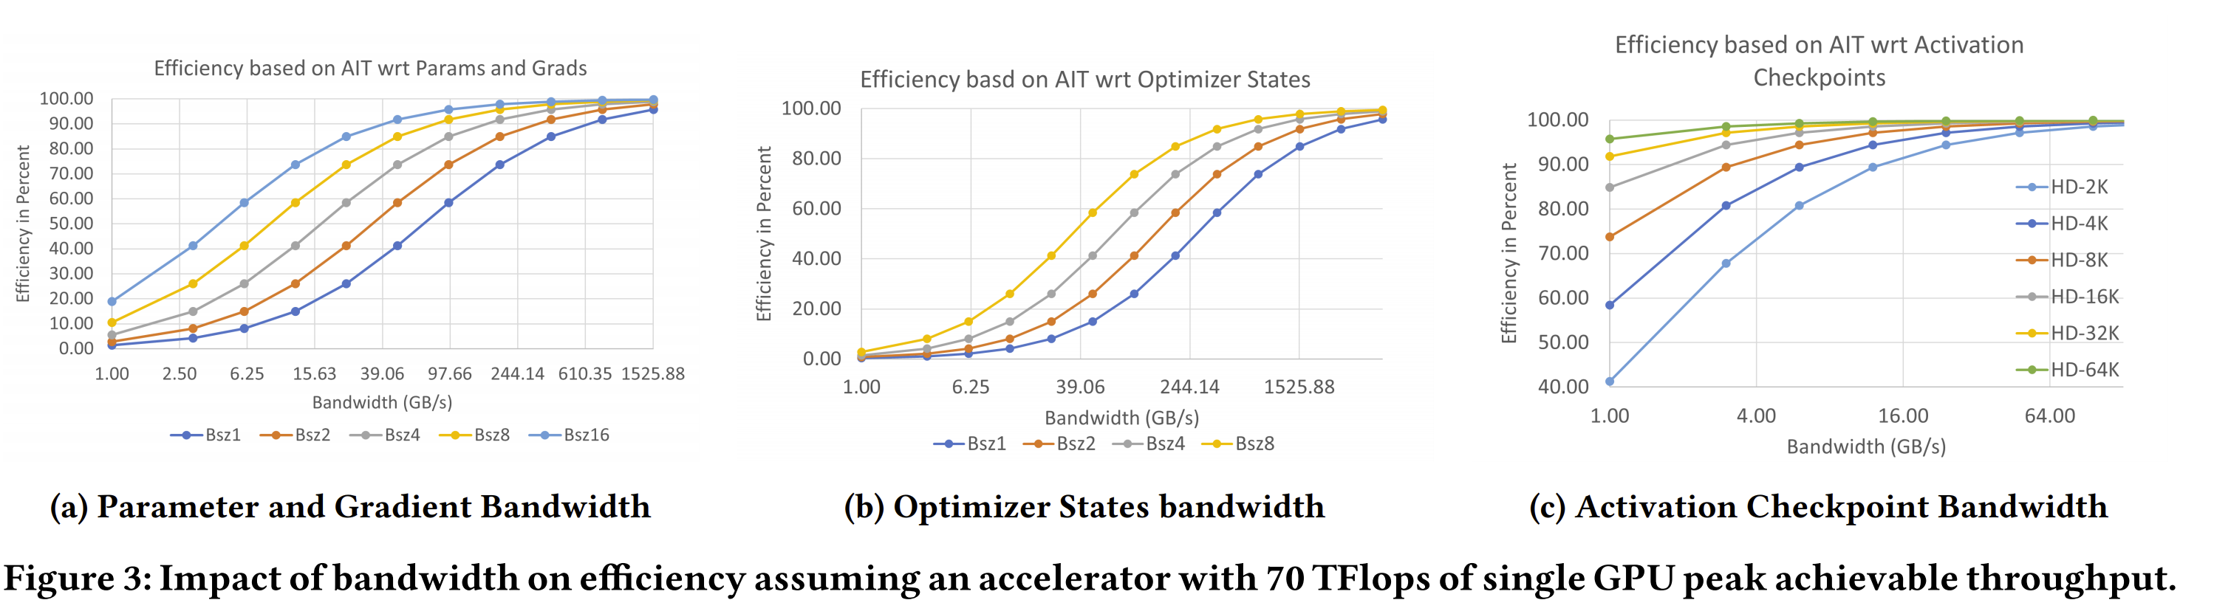
Efficiency as a function of bandwidth
Data Type | Overlap | Requirement
Params/Grads | Yes | 60 GB/s
Optimizer States | No | 1500 GB/s
Activations | Yes | 4 GB/s
Batch Size 2K tokens per GPU
Notes:
With our efficiency formulation, we can plot efficiency as a function of bandwidth for different data used during the training such as parameter, gradients, optimizer states and activations, for different batch sizes. These plots can tell us for a given data type, and batch size, how much bandwidth is necessary for ZeRO with CPU/NVMe offload to remain efficient.
For example, for the training with ZeRO to be efficient on a DGX-2 system where each GPU can achieve about 70 TFlops in real performance without communication, we need 60 GB/s offload communication bandwidth to read and write parameter and gradients, 1.5TB/s bandwidth for optimizer states, and 4 GB/s for activations if we use a batch size of 2K tokens per GPU.

Slide 69
ZeRO with CPU/NVME Offload
Example: Training using ZeRO with Offload on 64x DGX-2 nodes.
GPU Interconnect
ZeRO with non-GPU memory
GPU 0
GPU 1
GPU 2
GPUs | Data Type | Required | NVMe memory | CPU Memory
1024 | Params/Grads | 60 GB/s | 12 GB/s | 12 GB/s
1024 | Optimizer States | 1500 GB/s | 1792 GB/s | 4096 GB/s
1024 | Activations | 4 GB/s | 1.75GB/s | 4GB/s
PCIe
NVME
NVME
NVME
Layer 0
Layer 0
Layer 1
Layer 2
Is CPU/NVME←→ GPU bandwidth sufficient?
Params/grads: PCIe bottleneck 12 GB/s
Optimizer States: More than needed
Activations: CPU Memory bandwidth sufficient
Notes:
Given these requirements, lets consider training a massive model on 1K GPU 64 nodes DGX-2 cluster with ZeRO where parameters, gradients, optimizer states and activations are all offloaded to CPU or NVME memory.
The NVMe peak bw on a DGX-2 system is about 28GB/s, while the CPU memory bandwidth is a couple of hundreds of GB/s.
For parameters and gradients, since each parameter is owned by a unique GPU in ZeRO, the bandwidth from NVMe/CPU is limited by the PCIe link bandwidth between that GPU and the NVMe memory which is only about 12 GB/s. This severely restricts efficiency of ZeRO compared to running it directly from GPU memory.
Optimizer states on the other hand are updated in parallel across all nodes in ZeRO. Therefore, the required data movement can occur in parallel across all nodes, achieving an aggregate the NVMe bandwidth 1.7 TB/s bandwidth across 64 nodes. This is more than sufficient to achieve good efficiency.
Furthermore, while activation memory bandwidth from NVMe is insufficient, the bandwidth from CPU memory is sufficient to achieve good efficiency.
In summary, our analysis shows that ZeRO with CPU/NVMe Offload can enable offloading of optimizer states to NVMe, and activations to CPU memory but requires parameters and gradients to stay in GPU memory. While this is very encouraging, leaving parameters and gradients in GPU memory still creates a GPU memory bottleneck. Can we do better and offload everything to completely transcend the GPU memory wall while still remaining efficient?
This was one of the main motivations behind the design of ZeRO-Infinity.

Slide 70
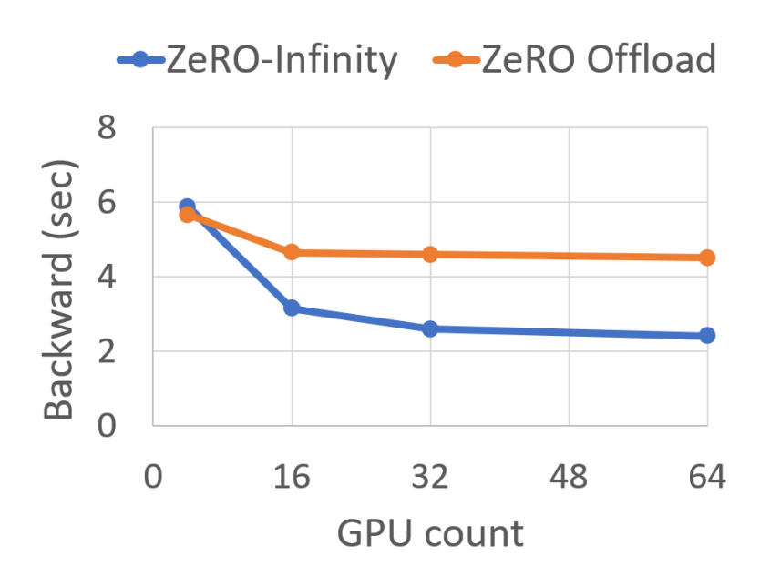
ZeRO-Infinity
GPU Interconnect
GPU 0
GPU 1
GPU 2
PCIe
Layer 0
Layer 0
NVME
NVME
NVME
Layer 1
Partition each parameter across GPUs
Send from NVMe to GPU in parallel
Allgather and Reduce-Scatter
Bandwidth Increases linearly with devices
#gpus x host-to-device bandwidth
CPU -> GPU: 64 GB/s – 4 TB/s (1-64 nodes)
NVMe -> GPU: 28 GB/s – 1.8 TB/s (1-64 nodes)
Limited by GPU←→GPU bw
min (#gpus x host-device bw, gpu-gpu bw)
70 GB/s
Layer 2
ZeRO Infinity
GPUs | Data Type | Required | NVMe memory | CPU Memory
1024 | Params/Grads | 60 GB/s | 70 GB/s | 70 GB/s
1024 | Optimizer States | 1500 GB/s | 1792 GB/s | 4096 GB/s
1024 | Activations | 4 GB/s | 1.75GB/s | 4GB/s
Weak Scaling:
ZeRO Infinity vs ZeRO Offload
Notes:
One of the core differences between ZeRO and ZeRO Infinity is in data partitioning and communication strategy. ZeRO Infinity partitions each individual parameter across all data parallel GPUs before offloading it to NVMe. When a parameter is needed during training, each of its partition is moved to the owner GPUs using multiple PCIe links in parallel. Then to reconstruct the full-parameter on each GPU, it uses an all-gather operation instead of a broadcast.
Note that this remapping of data allows the NVMe to GPU bandwidth to increase linearly with the number of data parallel GPUs. On a single DGX-2 we can achieve near peak NVMe bandwidth of 28GB/s and on a 64 node cluster, a massive 1.8 TB/s bandwidth, far beyond what is needed to offload parameters and gradients.
The impact of this linear increase in bandwidth is demonstrated with the figure in the bottom showing weak scaling of ZeRO-Infinity and ZeRO-Offload. Note that both of them have similar performance on a single GPU, but ZeRO-Infinity gets over 2x faster with larger number of nodes due to the increased aggregate NVMe bandwidth. In fact, at scale ZeRO-Infinity is no longer bottlenecked by the NVMe or CPU bandwidth but rather by the GPU-GPU bandwidth of the Allgather.
Next my colleague, Tunji will show ZeRO-Infinity in action and provide a deeper dive into optimizations and performance of ZeRO-Infinity.

Slide 71

ZeRO-Infinity in Action

Slide 72
Powerful Optimizations in ZeRO-Infinity
Layer i
Computing
Overlap Centric Design
GPU computation
GPU ←→ CPU, NVME ←→ CPU communication
GPU ←→ GPU communication
Infinity Offload Engine
DeepNVMe
Pinned Memory Management Layer
Can be used as an independent library
GPU
Prefetching
Layer i+1
CPU
Prefetching
Layer i+2
NVME
Overlapped layer prefetching during forward pass

Slide 73
Large model training landscape today
GPU Memory Wall
1T (10T) params: 800 (8K) V100 GPUs
How do we support the growth in model size?
Accessibility to large model training
256 GPUs to fine-tune GPT-3
Limited access to such resources
Model code refactoring
Re-writing the model using 3D parallelism (tensor-slicing + pipeline parallelism)
Painful and error prone
*AI and Memory Wall. (This blogpost has been written in… | by Amir Gholami | riselab | Medium

Slide 74
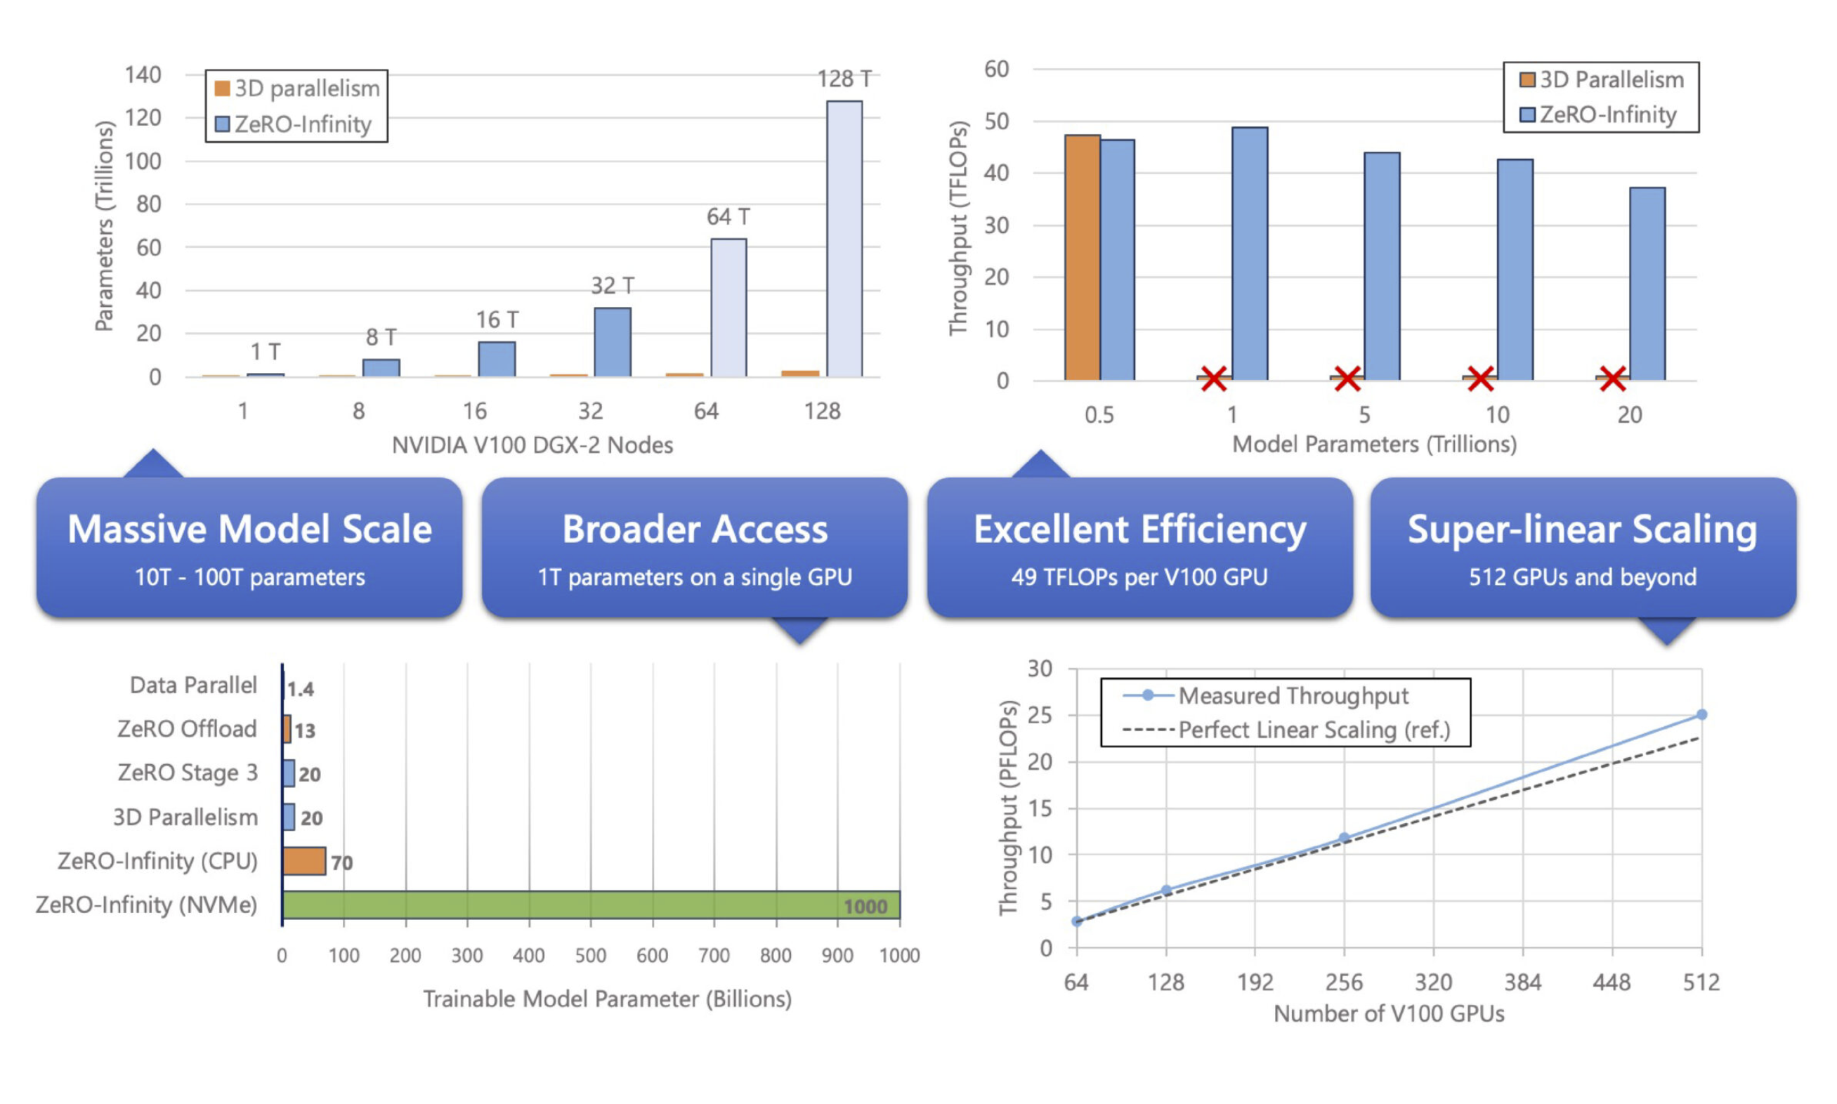
Redefining the landscape with ZeRO-Infinity
Beyond GPU Memory
50x larger models
32T params on 512 GPUs (instead of 25K)
Broader access to large model training
GPT-3 sized fine-tuning on a single node/GPU (instead of 16 nodes)
Excellent Throughput and Scalability
Comparable to 3D-parallelism
Ease of Use
No model refactoring necessary

Slide 75
Open-source DL library accelerating large scale training and inference on-top of PyTorch
https://github.com/microsoft/DeepSpeed
ZeRO
3D Parallelism
MoE training + inference
Optimized CUDA/ROCm/CPU kernels
Transformer, Adam, LAMB, AdaGrad, MoE
Optimized communication libraries
1-bit Adam/LAMB
Mixed precision training
Profiling and Auto-tuning
Sparse Attention
Mixture of Quantization (MoQ)
Progressive Layer Drop (PLD)
Curriculum Learning
Elastic training
Advanced learning rate schedules

Slide 76
Large model training landscape with DeepSpeed
2 years
100000
DeepSpeed Integration:
Huggingface
Pytorch Lightening
Catalyst
DeepSpeed Powered Massive Models:
Microsoft-Turing NLG 17B
GPT Neo-X 20B
Jurrasic-1 178B
Big Science 200B (ongoing)
Megatron-Turing NLG 530B
ZeRO-Infinity
10000
DeepSpeed :
ZeRO Offload +
3D-Parallelism
Max Transformer Size with DeepSpeed: 4000x /2 yrs
ZeRO-2
MT-NLG 530B
ZeRO-1
2021
2022
*max model size efficiently trainable on 64 DGX-2 SuperPod, 1024 V100 (32GB) with DeepSpeed
*AI and Memory Wall. (This blogpost has been written in… | by Amir Gholami | riselab | Medium

Slide 77
Extra reading/resources
Blogs
ZeRO & DeepSpeed: New system optimizations enable training models with over 100 billion parameters - Microsoft Research
Turing-NLG: A 17-billion-parameter language model by Microsoft - Microsoft Research
ZeRO-2 & DeepSpeed: Shattering barriers of deep learning speed & scale - Microsoft Research
DeepSpeed: Extreme-scale model training for everyone - Microsoft Research
ZeRO-Infinity and DeepSpeed: Unlocking unprecedented model scale for deep learning training - Microsoft Research
DeepSpeed: Accelerating large-scale model inference and training via system optimizations and compression - Microsoft Research
DeepSpeed: Advancing MoE inference and training to power next-generation AI scale - Microsoft Research
Using DeepSpeed and Megatron to Train Megatron-Turing NLG 530B, the World’s Largest and Most Powerful Generative Language Model - Microsoft Research
Papers
ZeRO: Memory Optimizations Toward Training Trillion Parameter Models - Microsoft Research
ZeRO: Offload 2101.06840v1.pdf (arxiv.org)
ZeRO-Infinity: Breaking the GPU Memory Wall for Extreme Scale Deep Learning - Microsoft Research
Scalable and Efficient MoE Training for Multitask Multilingual Models - Microsoft Research
1-bit LAMB: Communication Efficient Large-Scale Large-Batch Training with LAMB's Convergence Speed - Microsoft Research
1-bit Adam: Communication Efficient Large-Scale Training with Adam's Convergence Speed - Microsoft Research
DeepSpeed-MoE: Advancing Mixture-of-Experts Inference and Training to Power Next-Generation AI Scale - Microsoft Research
[2201.11990v1] Using DeepSpeed and Megatron to Train Megatron-Turing NLG 530B, A Large-Scale Generative Language Model (arxiv.org)
Large batch training with SimiGrad: 2021_NIPS_SimiGrad.pdf (unr.edu)
Accelerating Training of Transformer-Based Language Models with Progressive Layer Dropping - Microsoft Research

Slide 78
Thank You!
www.deepspeed.ai
is hiring

